Slide 1
The African Monsoon Recent Evolution and Current Status Include Week-1 and Week-2 Outlooks
Update prepared
03 June 2024
For more information, visit:
http://www.cpc.ncep.noaa.gov/products/Global_Monsoons/African_Monsoons/precip_monitoring.shtml

Slide 2
Outline
Highlights
Recent Evolution and Current Conditions
NCEP GEFS Forecasts
Summary

Slide 3
Highlights: Last 7 Days
During the past 7 days, in West Africa, rainfall was below-average over many parts of the Gulf of Guinea region. In contrast, above-average rainfall was observed over pockets of southern Senegal, western Burkina Faso and the far northern Nigeria. In Central Africa, much of Gabon, eastern CAR, and parts of western DRC received above-average rainfall. In contrast, rainfall was below-average over western and central CAR, much of Congo, and parts of central, eastern and northern DRC. In Eastern Africa, above-average rainfall was observed over western and central South Sudan, while suppressed rainfall prevailed over parts of Uganda and Ethiopia.
The Week-1 outlooks call for moderate to high tilt in the odds to favor below-normal rainfall over much of the Gulf of Guinea region, northwestern and central Ethiopia, eastern Uganda, parts of southern Somalia, and the far eastern Tanzania and Madagascar. In contrast, there is a moderate to high tilt in the odds to favor above-average rainfall over northern Nigeria, southern Niger, southeastern Chad, eastern CAR, parts of central and northern DRC, southern Sudan, southeastern South Sudan and southwestern Ethiopia. For week-2, there is a moderate to high tilt in the odds to favor above-average rainfall across the central and eastern parts of the Sahel region, including parts of southern Sudan, northern South Sudan and western Ethiopia. In contrast, the forecasts call for moderate to high tilt in the odds to favor below-normal rainfall over southern Senegal, Guinea-Bissau, western Guinea, eastern Liberia, western Côte d’Ivoire, southern CAR, northern DRC, central South Sudan, southern Uganda, western Kenya, and parts of southern Ethiopia.

Slide 4
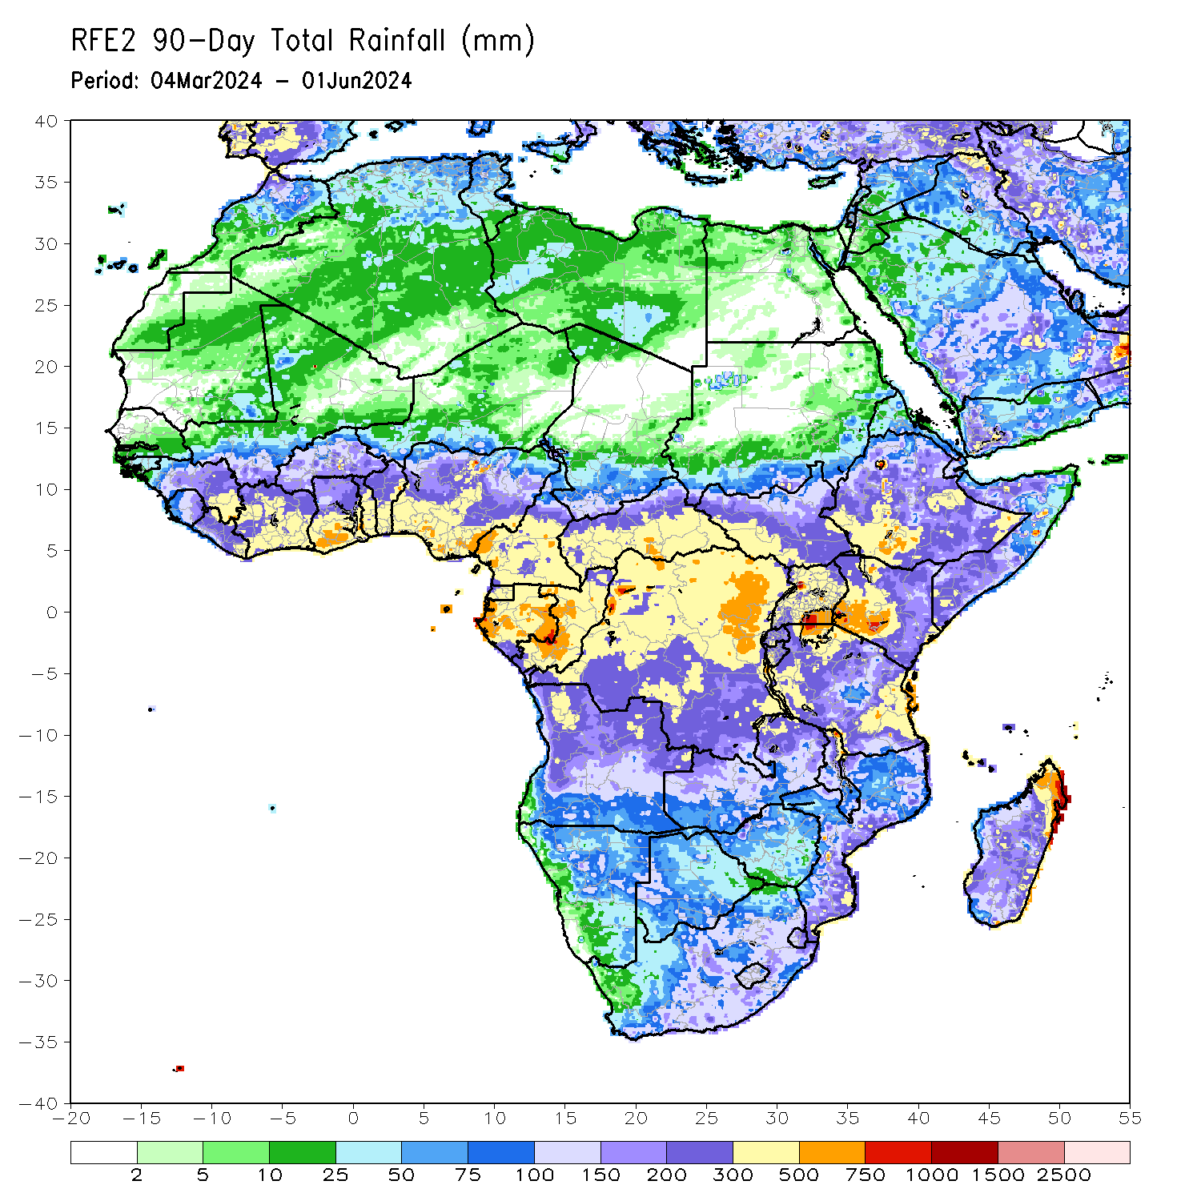
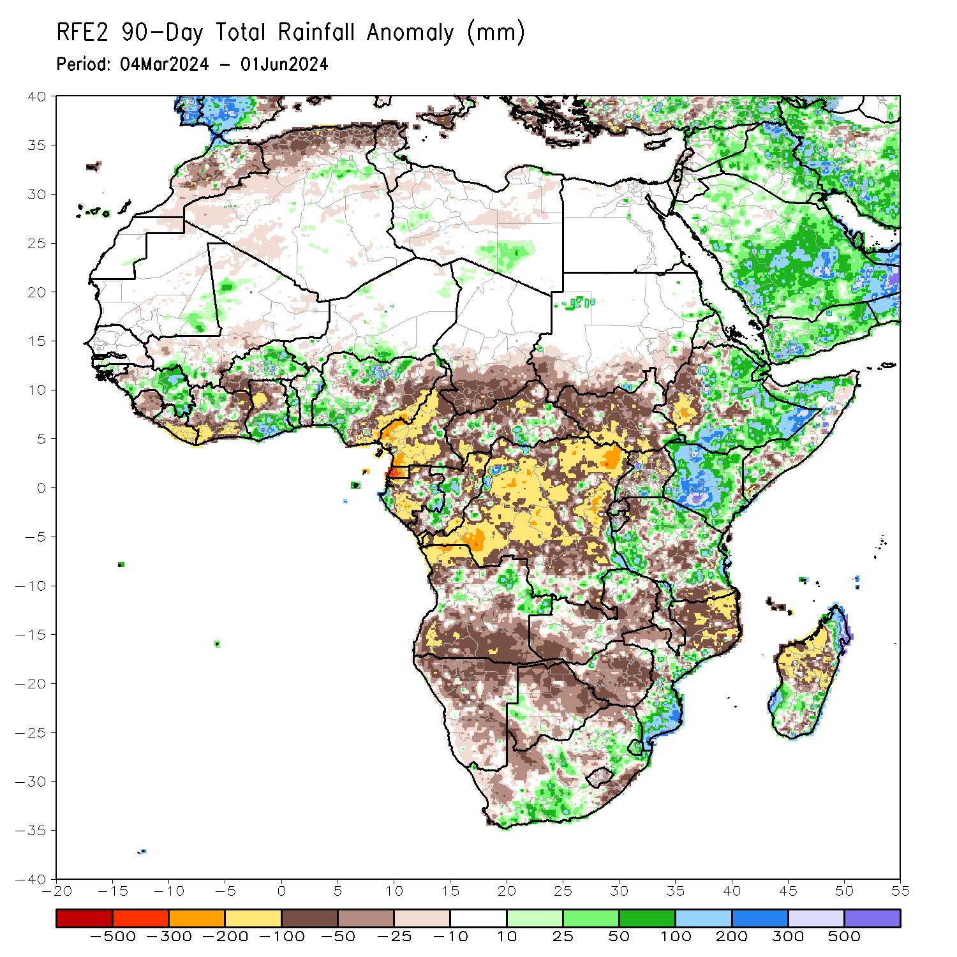
Rainfall Patterns: Last 90 Days
Over the past 90 days, in East Africa, rainfall was above-average over much of northern, central. Eastern and southern Ethiopia, much of Kenya, northern Somalia, pockets of southern Uganda, and parts of Tanzania. Below-average rainfall was observed over much of South Sudan, parts of southern Sudan, western Ethiopia, much of Uganda, parts of Tanzania and pockets of Southern Ethiopia. In Central Africa, above-average rainfall was observed over pockets of Gabon, Congo, DRC and CAR. In contrast, below-average rainfall was observed over much of Cameroon, southern Chad, much CAR, Equatorial Guinea, and much of Gabon and DRC. In Southern Africa, rainfall was below-average over much of Angola, Zambia, Zimbabwe, parts of Malawi, northern Mozambique, Namibia, Botswana, pockets of South Africa, and northwestern and central Madagascar. In contrast, above-average rainfall was observed over northeastern Angola, the far western Botswana, parts of South Africa southern Mozambique and southern and northeastern Madagascar. In West Africa, above-average rainfall was observed over eastern Guinea, northern Cote d’Ivoire, eastern Burkina Faso, southern Ghana, Togo, Benin, southwestern and northern Nigeria. In contrast, rainfall was below-average over Sierra Leone, Liberia, southern and eastern Cote d’Ivoire, northern Ghana and eastern Nigeria.
Notes:
4

Slide 5
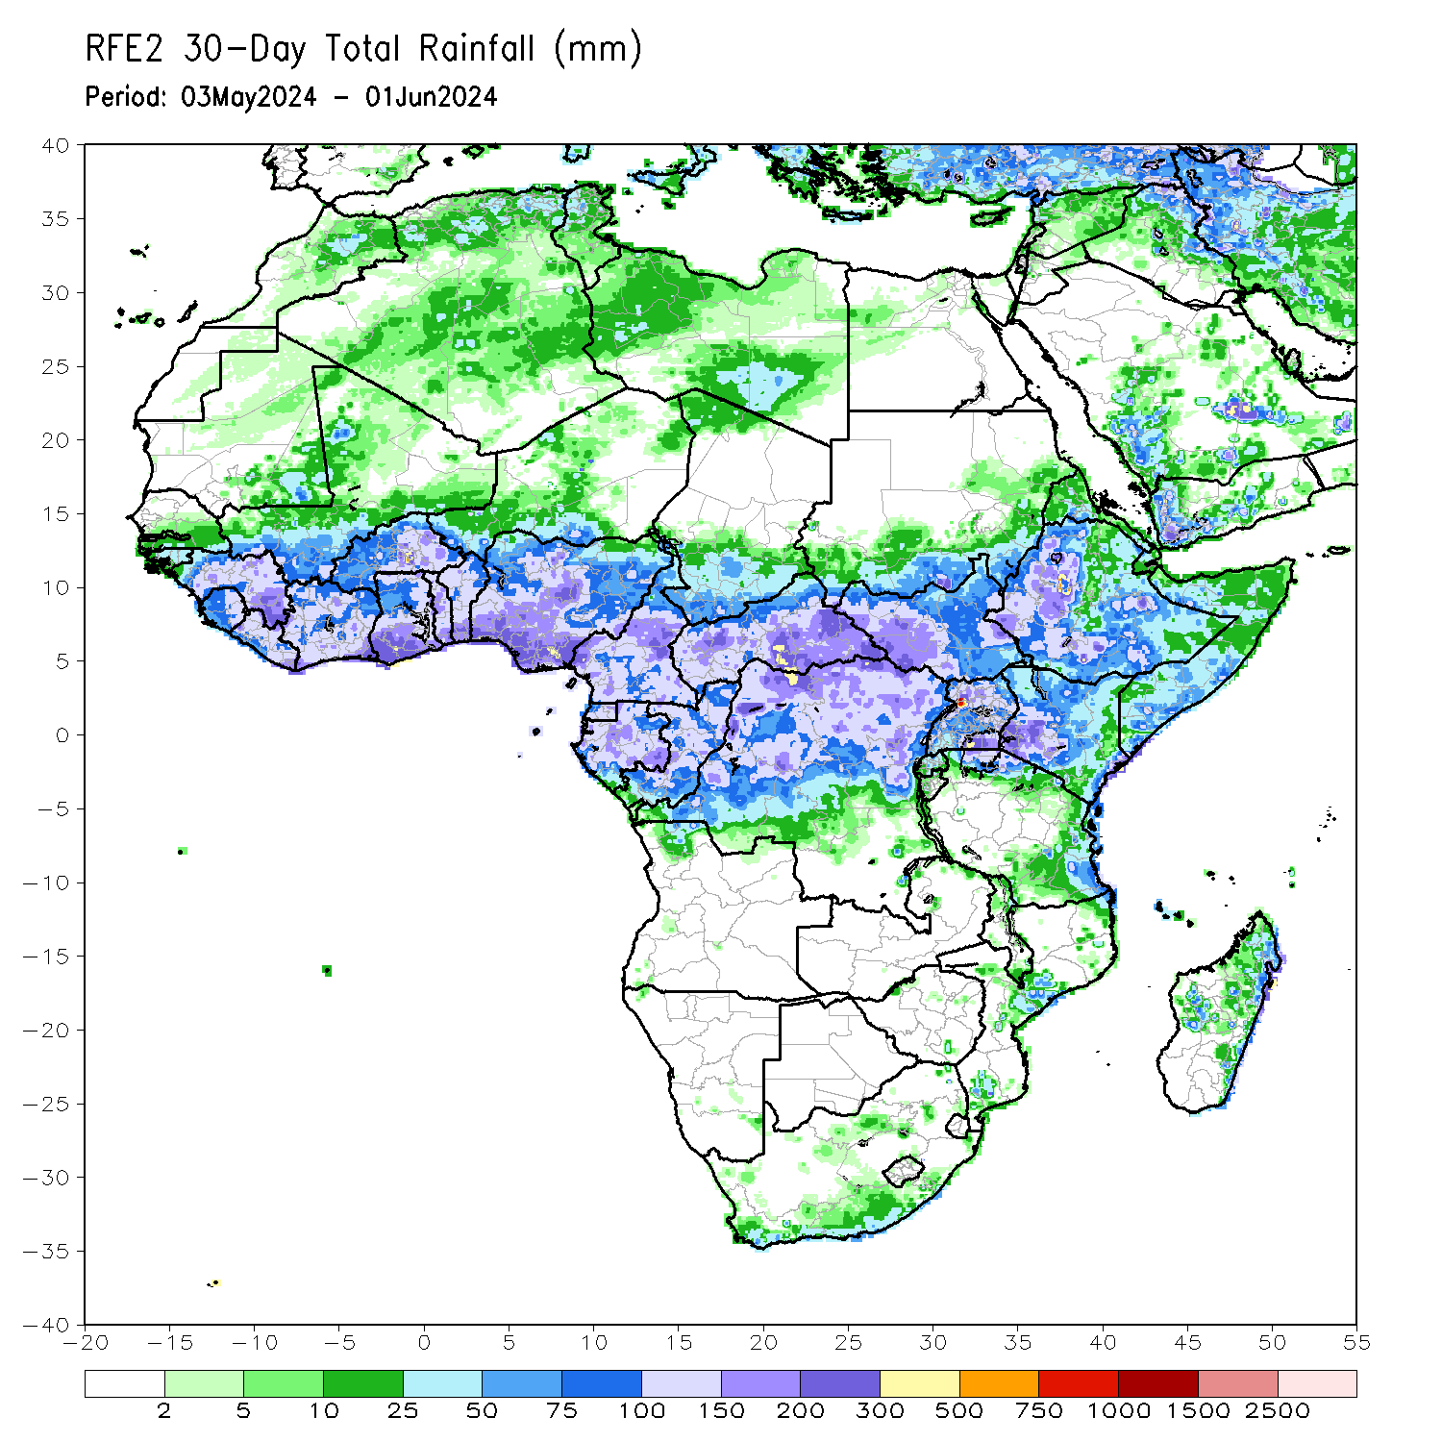
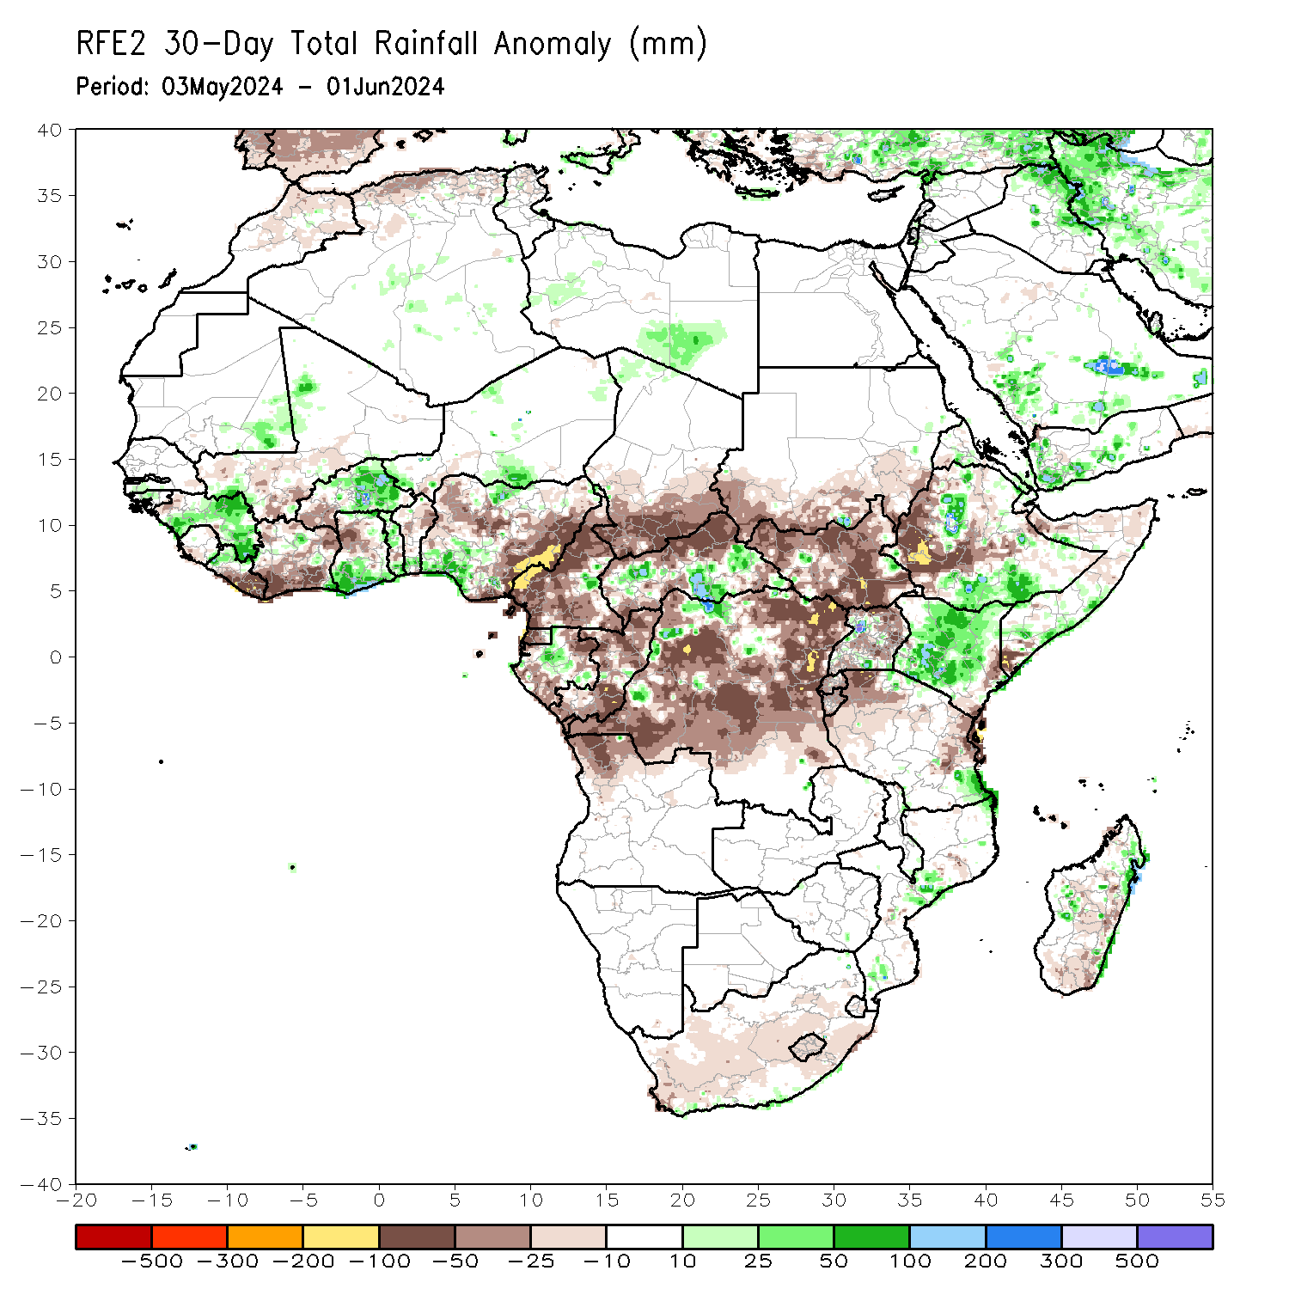
Rainfall Patterns: Last 30 Days
In the past 30 days, in West Africa, rainfall was above-average over central and eastern Guinea, eastern Burkina Faso, southern Ghana, and the far southern and northern Nigeria. In contrast, below-average rainfall was observed over eastern Liberia, southwestern Mali, parts of Cote d’Ivoire, western Burkina Faso, northern Ghana, and northwestern and eastern Nigeria. In Central Africa, rainfall was below-average over much of Nigeria, southern Chad, northern CAR, parts of Gabon, Congo, and many parts of DRC. In contrast, above-average rainfall was observed over pockets of CAR, Gabon, and northern DRC. In East Africa, below-average rainfall was observed over much South Sudan, southern Sudan, parts of western and central Ethiopia, Uganda, Rwanda, Burundi, parts of Tanzania and the far southern Somalia. In Southern Africa, pockets of central Mozambique and Madagascar received above-average rainfall.
Notes:
5

Slide 6
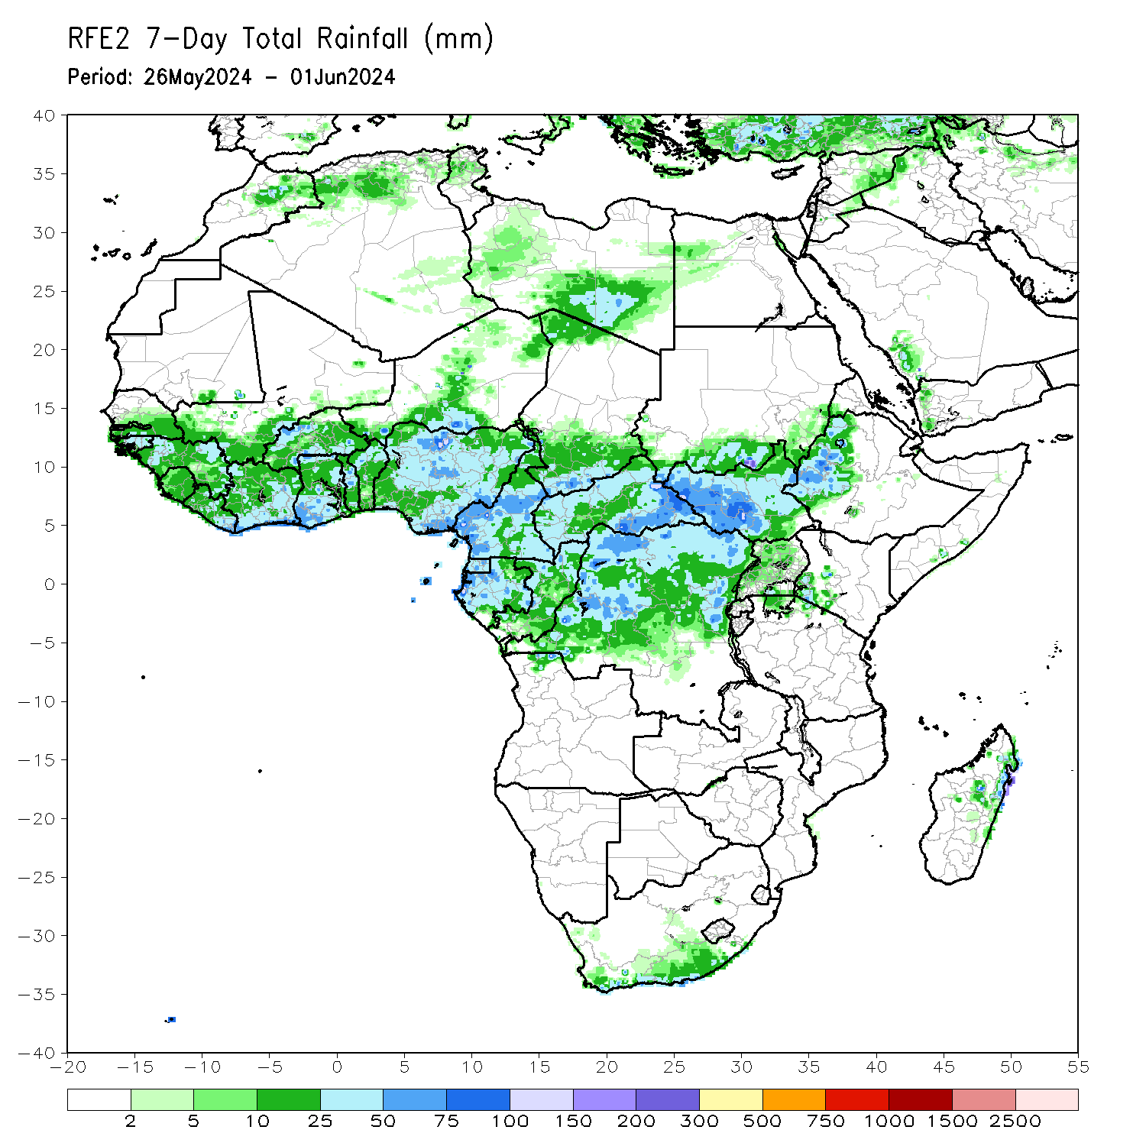
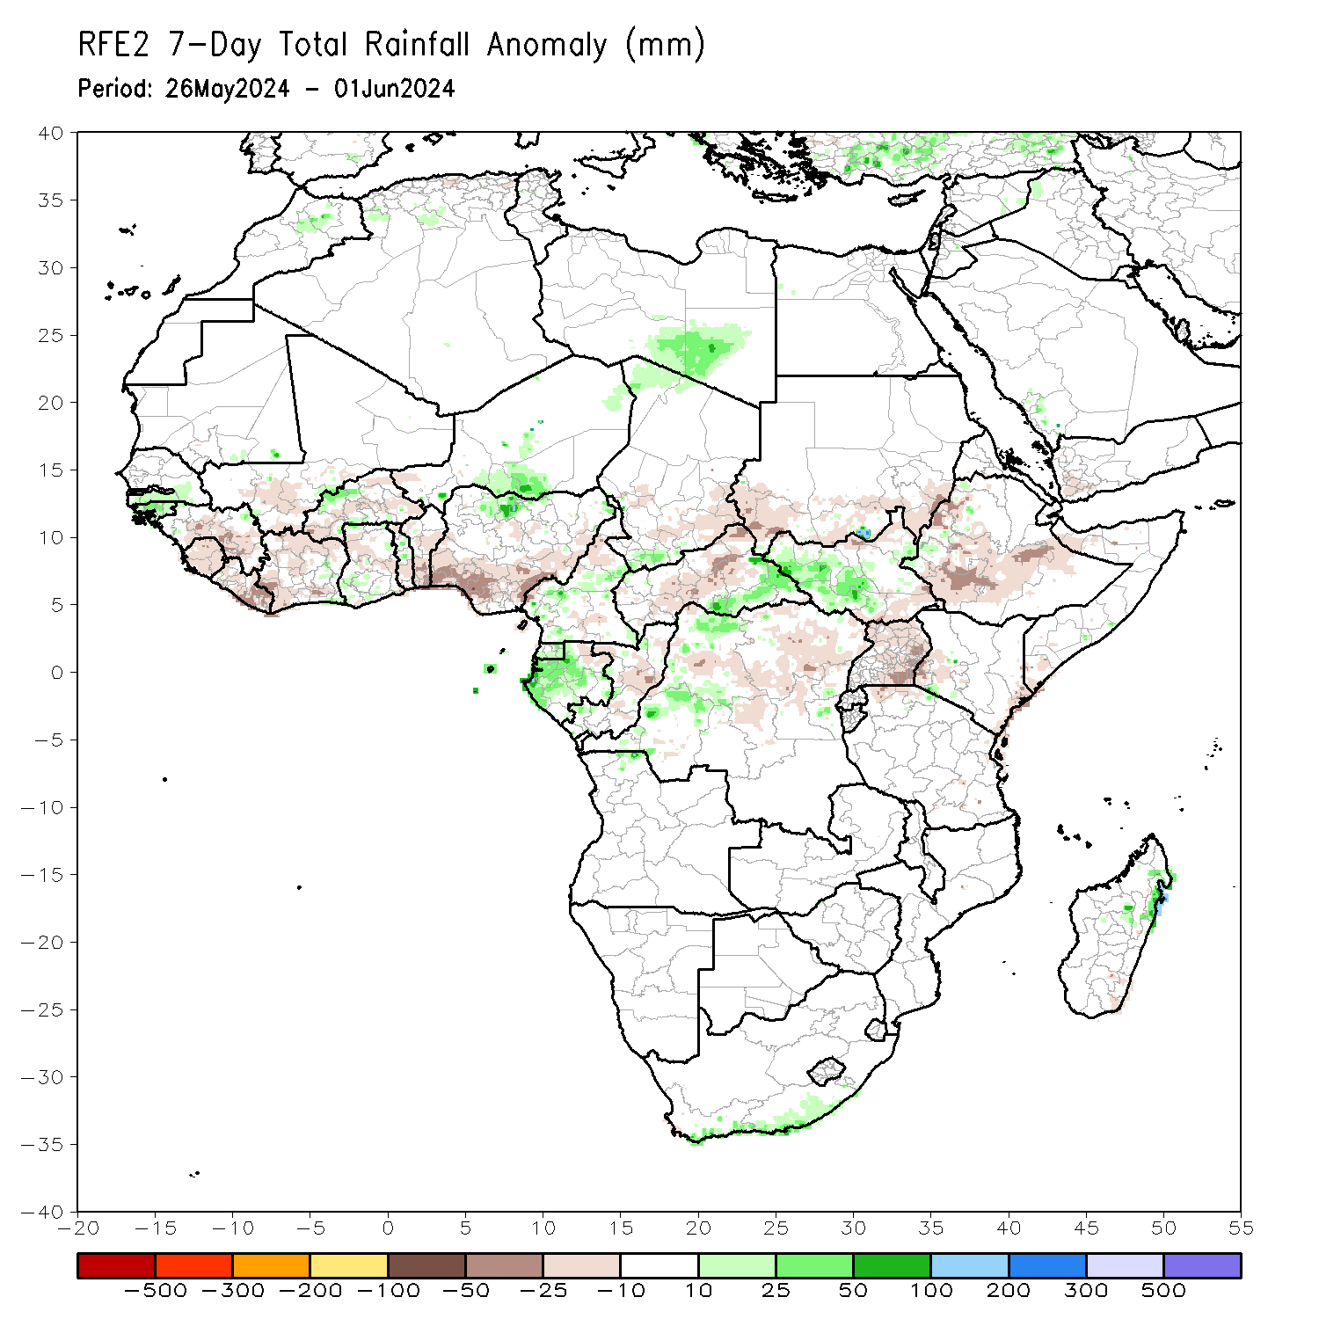
Rainfall Patterns: Last 7 Days
During the past 7 days, in West Africa, rainfall was below-average over many places of the Gulf of Guinea region. In contrast, above-average rainfall was observed over pockets of southern Senegal, western Burkina Faso and the far northern Nigeria. In Central Africa, much of Gabon, eastern CAR, and parts of western DRC received above-average rainfall. In contrast, rainfall was below-average over western and central CAR, much Congo, and parts of central, eastern and northern DRC. In Eastern Africa, above-average rainfall was observed over western and central South Sudan, while suppressed rainfall prevailed over parts of Uganda and Ethiopia.

Slide 7
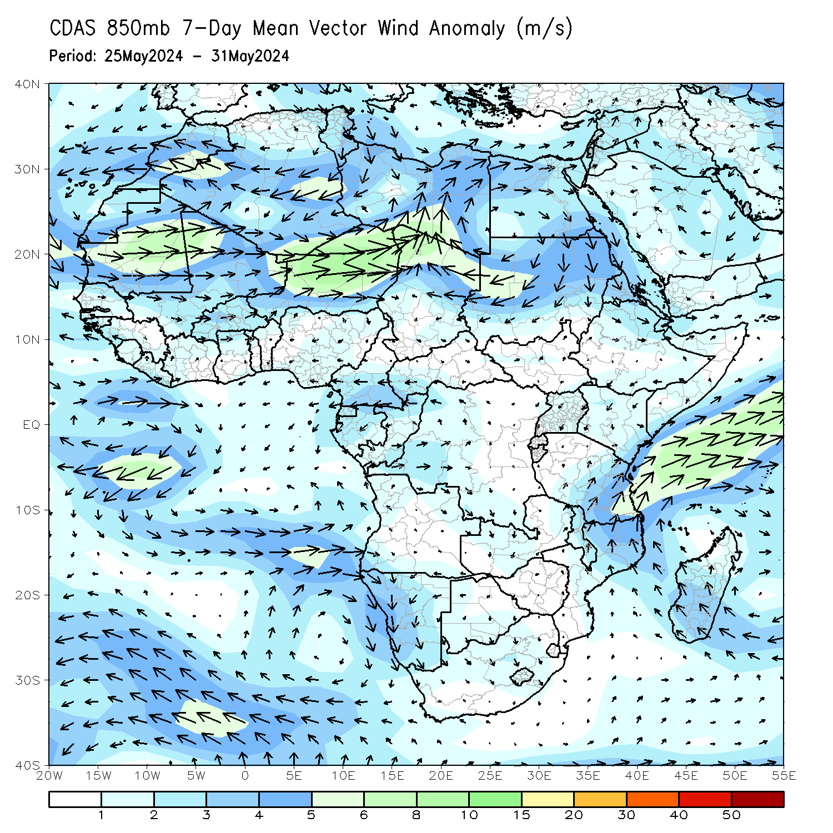
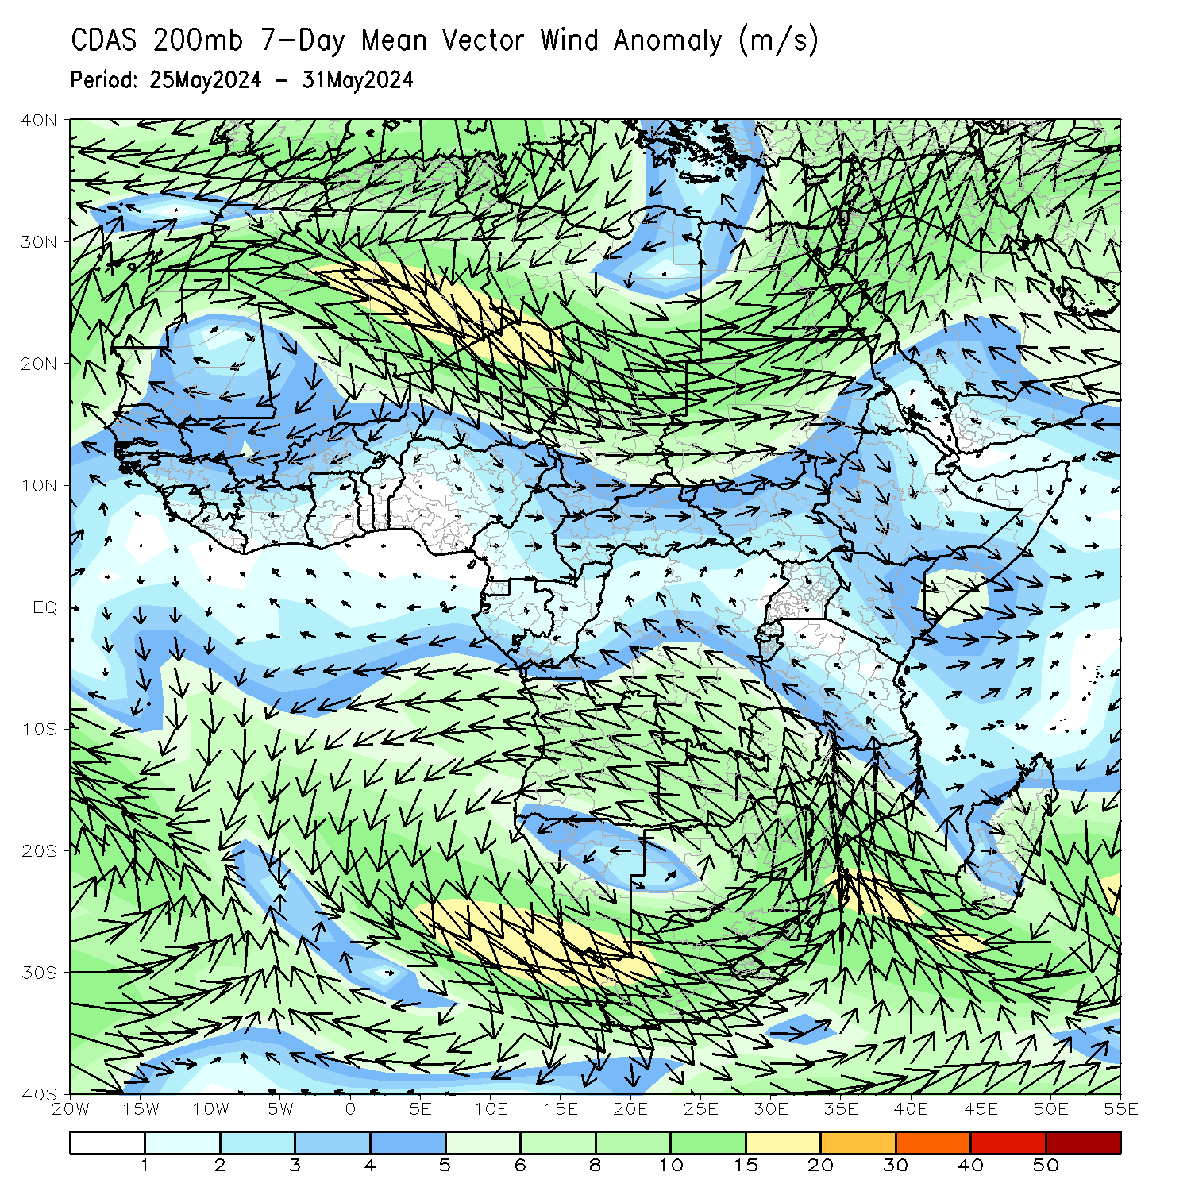
Atmospheric Circulation: Last 7 Days
At 8500-hPa level (left panel), the low level jet (LLJ) remained stronger than normal across the western Indian Ocean and the neighboring areas of East Africa.

Slide 8
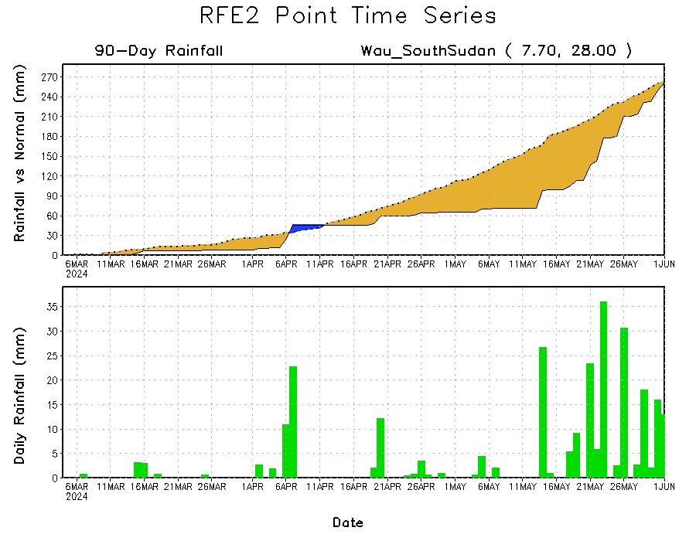
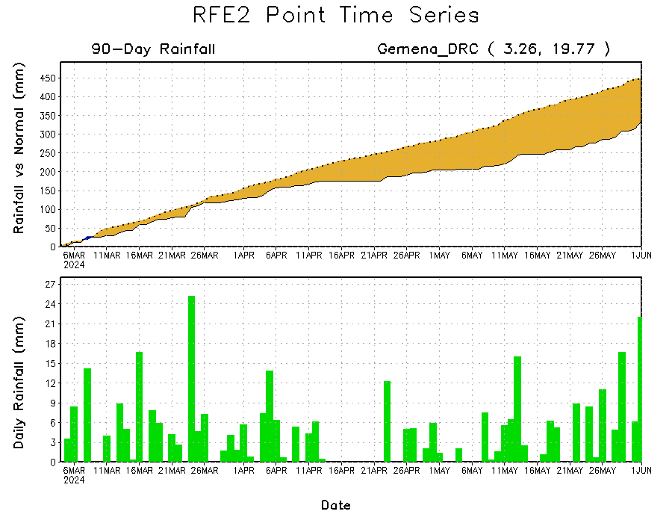
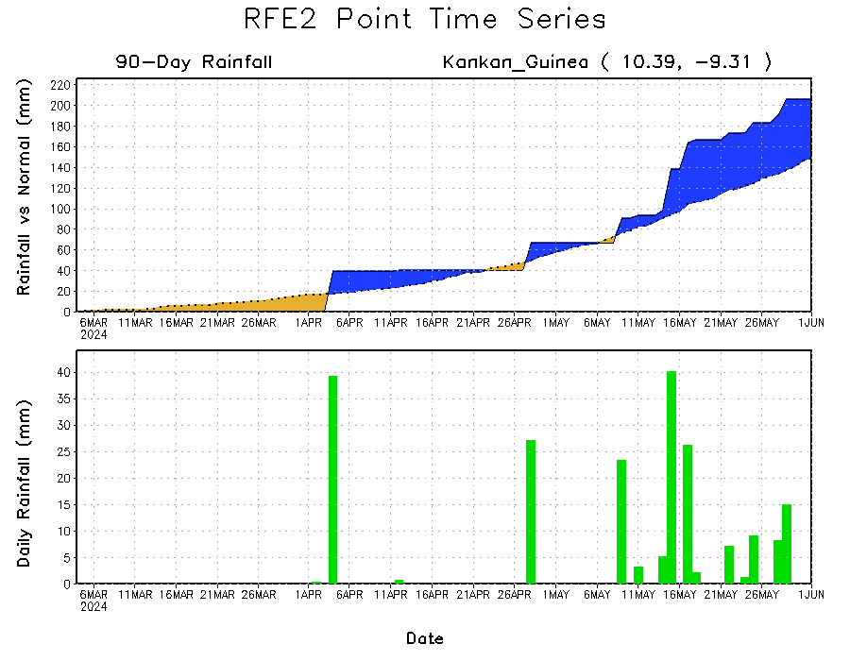
Rainfall Evolution
Daily evolution in rainfall at selected locations over the past 90 days shows that moderate to heavy rains resulted in moisture surpluses over parts of eastern Guinea (bottom left), and helped to reduce accumulated rainfall deficits over parts of South Sudan (top right). Seasonal total rainfall remained below average over parts of northern DRC (bottom right).

Slide 9
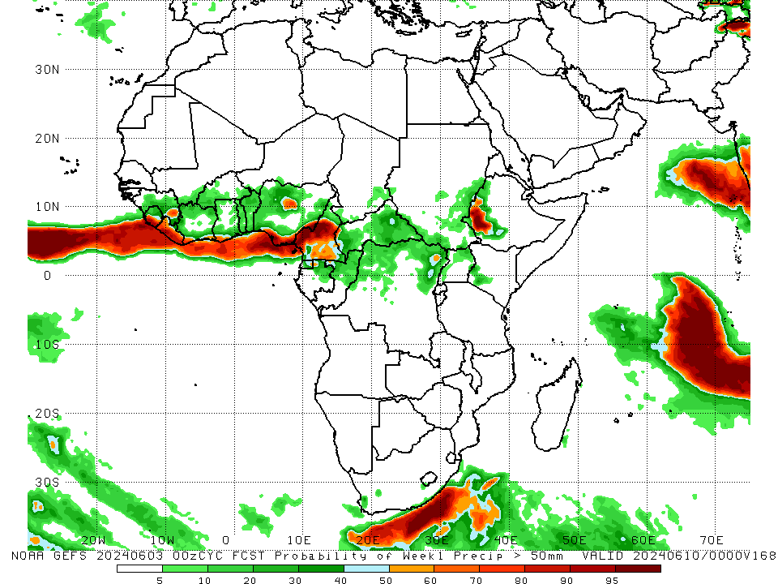
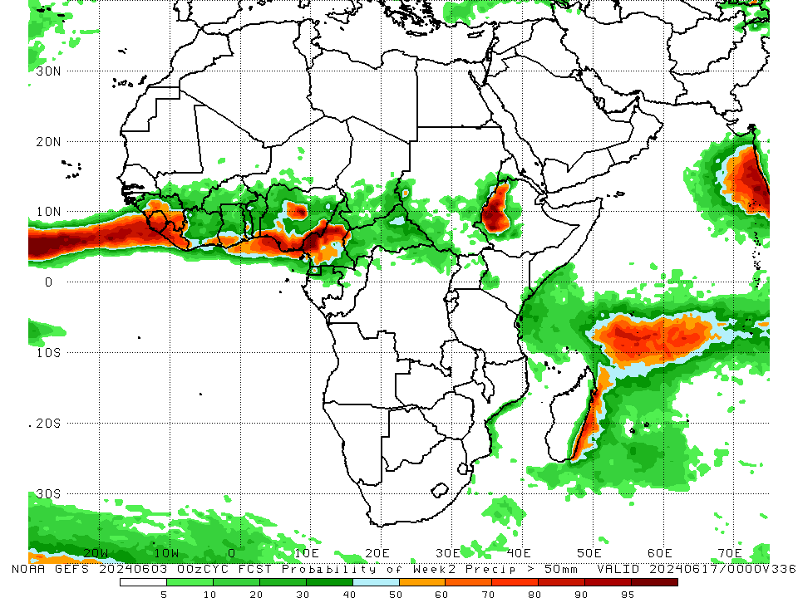
NCEP GEFS Model Forecasts Non-Bias Corrected Probability of precipitation exceedance
Week-1, Valid: 04 – 10 Jun, 2024
Week-2, Valid: 11 – 17 Jun, 2024
For week-1 (left panel) and Week-2 (right panel), the NCEP GEFS indicates a moderate to high chance (over 70%) for rainfall to exceed 50 mm along the gulf of Guinea coast, and southwestern Ethiopia.
Notes:
9

Slide 10
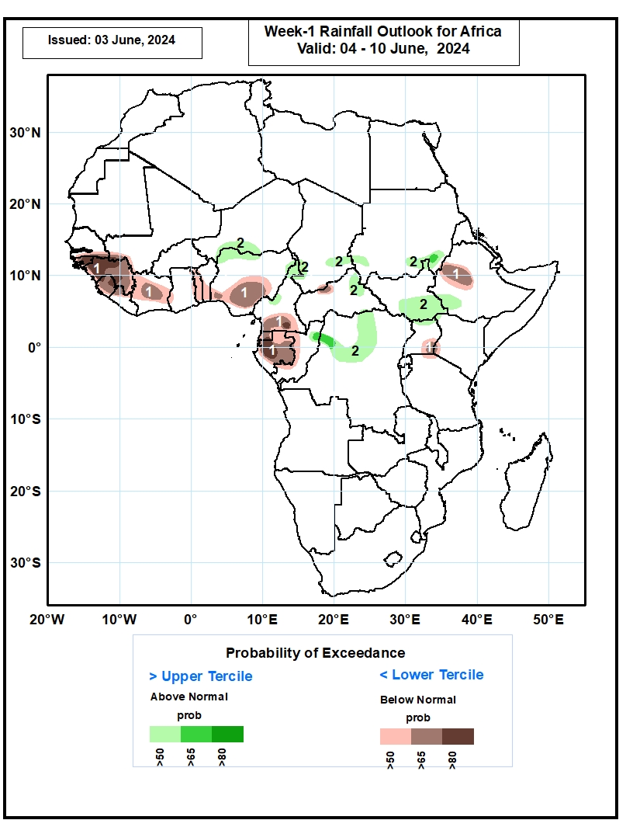
Week-1 Precipitation Outlooks
04 – 10 Jun, 2024
The probabilistic forecasts call for above 50% chance for weekly total rainfall to be below-normal (below the upper tercile) over southern Senegal, Guinea-Bissau, Guinea, Sierra Leone, northern Liberia, northern and central Cote d’Ivoire, Togo, central and southern Benin, central and southern Nigeria, , southern Cameroon, Equatorial Guinea, much of Gabon, western Congo, north-central CAR, western Ethiopia, southeastern Uganda, and southwestern Kenya. There is above 80% chance for below-normal rainfall over Guinea-Bissau, western, northern and eastern Guinea, northern Sierra Leone, and western Gabon.
The probabilistic forecasts call for above 50% chance for weekly rainfall to be above-normal (above the lower tercile) over southern Niger, northern Nigeria, northern and central Cameroon, southern Chad, northeastern CAR, northern Congo, northern and central DR Congo, southern Sudan, southern South Sudan, southwestern Ethiopia, and northern Uganda. There is above 65% chance for above-normal rainfall over northern Congo, northwestern DR Congo, and southeastern Sudan.
Notes:
10

Slide 11
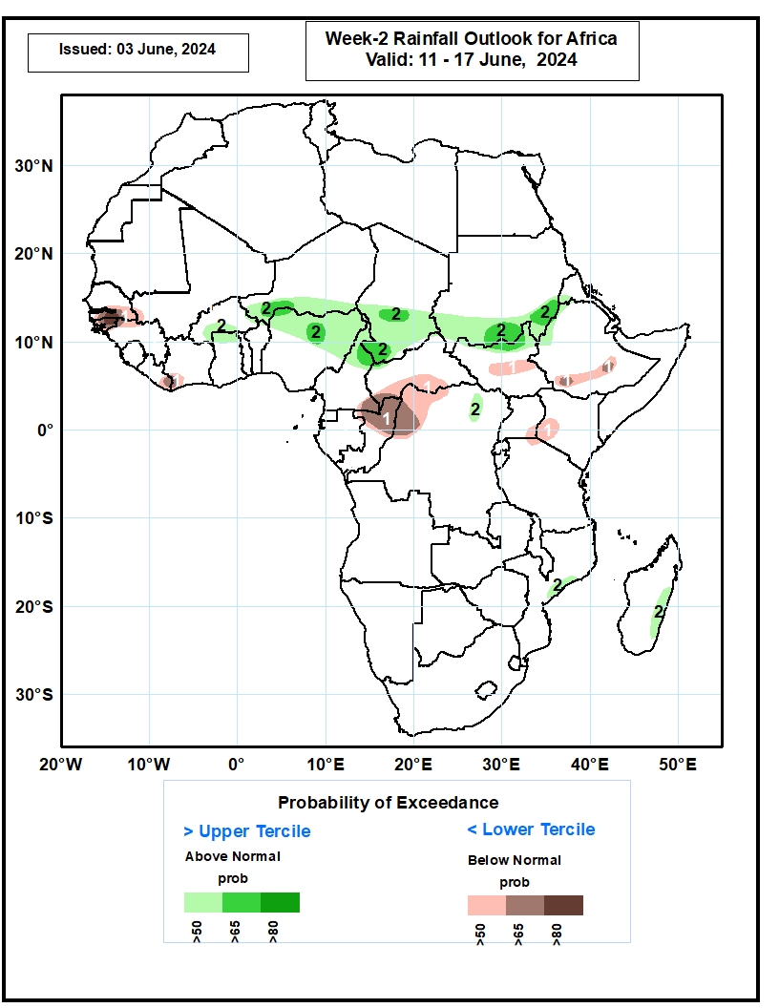
Week-2 Precipitation Outlooks
11 – 17 June, 2024
The probabilistic forecasts call for above 50% chance for weekly total rainfall to be below-normal (below the upper tercile) over The Gambia, southern Senegal, Guinea-Bissau, northwestern Guinea, southwestern Mali, eastern Liberia, southwestern Cote d’Ivoire, southeastern Cameroon, southern CAR, northern Congo, northwestern DR Congo, central South Sudan, southern Ethiopia, southeastern Uganda, southwestern Kenya, and north-central Tanzania. There is above 80% chance for below-normal rainfall over south-central Senegal, and much of Guinea-Bissau.
The probabilistic forecasts call for above 50% chance for weekly rainfall to be above-normal (above the lower tercile) over southern Burkina Faso, northern Ghana, southern Niger, northern and eastern Nigeria, northern Cameroon, southern Chad, southern Sudan, northern South Sudan, southwestern Eritrea, western Ethiopia, northeastern DR Congo, east-central Mozambique, and eastern Madagascar. There is above 65% chance for above-normal rainfall over southwestern Niger, northern Nigeria, northern Cameroon, southern Chad, and southern Sudan.
Notes:
11

Slide 12
Summary
In the past 30 days, in West Africa, rainfall was above-average over central and eastern Guinea, eastern Burkina Faso, southern Ghana, and the far southern and northern Nigeria. In contrast, below-average rainfall was observed over eastern Liberia, southwestern Mali, parts of Cote d’Ivoire, western Burkina Faso, northern Ghana, and northwestern and eastern Nigeria. In Central Africa, rainfall was below-average over much of Nigeria, southern Chad, northern CAR, parts of Gabon, Congo, and many parts of DRC. In contrast, above-average rainfall was observed over pockets of CAR, Gabon, and northern DRC. In East Africa, below-average rainfall was observed over much South Sudan, southern Sudan, parts of western and central Ethiopia, Uganda, Rwanda, Burundi, parts of Tanzania and the far southern Somalia. In Southern Africa, pockets of central Mozambique and Madagascar received above-average rainfall.
During the past 7 days, in West Africa, rainfall was below-average over many parts of the Gulf of Guinea region. In contrast, above-average rainfall was observed over pockets of southern Senegal, western Burkina Faso and the far northern Nigeria. In Central Africa, much of Gabon, eastern CAR, and parts of western DRC received above-average rainfall. In contrast, rainfall was below-average over western and central CAR, much of Congo, and parts of central, eastern and northern DRC. In Eastern Africa, above-average rainfall was observed over western and central South Sudan, while suppressed rainfall prevailed over parts of Uganda and Ethiopia.
The Week-1 outlooks call for moderate to high tilt in the odds to favor below-normal rainfall over much of the Gulf of Guinea region, northwestern and central Ethiopia, eastern Uganda, parts of southern Somalia, and the far eastern Tanzania and Madagascar. In contrast, there is a moderate to high tilt in the odds to favor above-average rainfall over northern Nigeria, southern Niger, southeastern Chad, eastern CAR, parts of central and northern DRC, southern Sudan, southeastern South Sudan and southwestern Ethiopia. For week-2, there is a moderate to high tilt in the odds to favor above-average rainfall across the central and eastern parts of the Sahel region, including parts of southern Sudan, northern South Sudan and western Ethiopia. In contrast, the forecasts call for moderate to high tilt in the odds to favor below-normal rainfall over southern Senegal, Guinea-Bissau, western Guinea, eastern Liberia, western Côte d’Ivoire, southern CAR, northern DRC, central South Sudan, southern Uganda, western Kenya, and parts of southern Ethiopia.

