Slide 1
The African Monsoon Recent Evolution and Current Status Include Week-1 and Week-2 Outlooks
Update prepared
20 May 2024
For more information, visit:
http://www.cpc.ncep.noaa.gov/products/Global_Monsoons/African_Monsoons/precip_monitoring.shtml

Slide 2
Outline
Highlights
Recent Evolution and Current Conditions
NCEP GEFS Forecasts
Summary

Slide 3
Highlights: Last 7 Days
During the past 7 days, in East Africa, rainfall was above-average in northwestern and central parts of Ethiopia, and pocket of regions in western Eritrea, northwestern Uganda, northern Tanzania and some localized regions in eastern and western South Sudan. Rainfall was below-average in southwestern Ethiopia, some regions in central Somalia, northern, central, southern and southeastern South Sudan, many parts of Uganda and Rwanda, northern Burundi, northwestern Tanzania, and some parts of western and eastern Kenya. In central Africa, rainfall was above-average in parts of southeastern Cameroon, southwestern, central, southern and eastern parts of Central African Republic (CAR), and northwestern and northern parts of Democratic Republic of the Congo (DRC). Rainfall was below-average in central, eastern, western and southern Cameroon, Equatorial Guinea, some parts of western, northern and eastern Gabon, central Congo, southern Chad, northwestern and northern CAR, and southwestern, central, northeastern and eastern DRC. In West Africa, rainfall was above-average in southeastern Mauritania, some parts of western and southern Mali, central and eastern Guinea, Sierra Leone, western and northern Liberia, western and central-eastern Cote d’Ivoire, western, southern and northern Ghana, northern Togo, central Benin, and central and eastern Burkina Faso, and southern Nigeria. Rainfall was below-average in eastern Liberia, southeastern Cote d’Ivoire, western Burkina Faso, southern Togo, and central, southeastern and eastern Nigeria. In southern Africa, rainfall was above-average in some regions in central and southern Mozambique, and northern and some localized regions in western and southeastern Madagascar. Rainfall was below-average in the northern Angola region.
The Week-1 outlook calls for above-average rainfall in western Ethiopia, central Somalia, southeastern South Sudan, eastern Democratic Republic of the Congo (DRC), many parts of Uganda, western and eastern Kenya, and eastern Tanzania. In contrast, there is an increased chance for below-average in many parts of the Gulf of Guinea coast countries, equatorial and central Africa, southern Chad, southwestern Sudan, central and southeastern Ethiopia, and northwestern and southern Somalia. The Week-2 outlook calls for above-average rainfall in Sierra Leone, southern Niger, some parts of northern, central and southeastern Nigeria, central Cameroon, southwestern Ethiopia, and pocket of regions in southeastern Central African Republic (CAR) and central Mozambique. In contrast, there is an increased chance for below-average in Equatorial Guinea, Gabon, Congo, western, northern and central Congo, eastern Tanzania, southern Somalia, eastern Ethiopia, eastern Liberia, southern Cote d’Ivoire, Togo, central and southern Benin, and southwestern Nigeria.

Slide 4
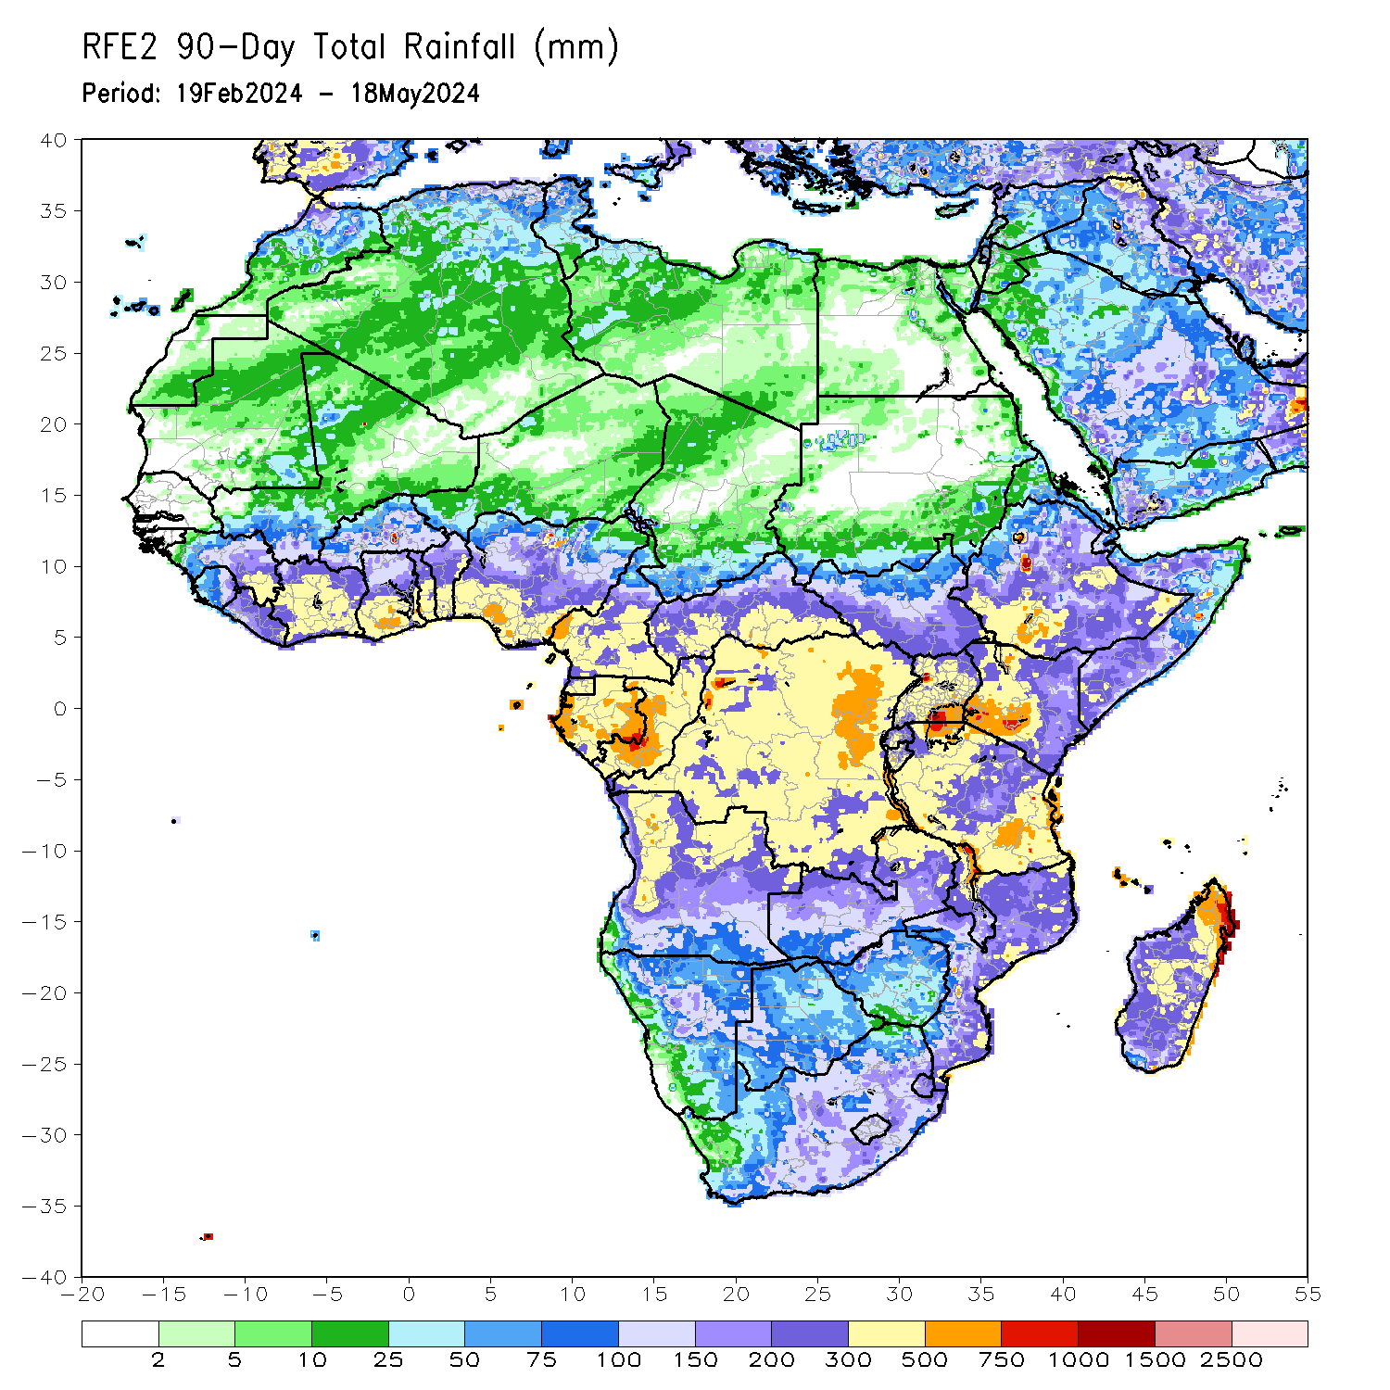
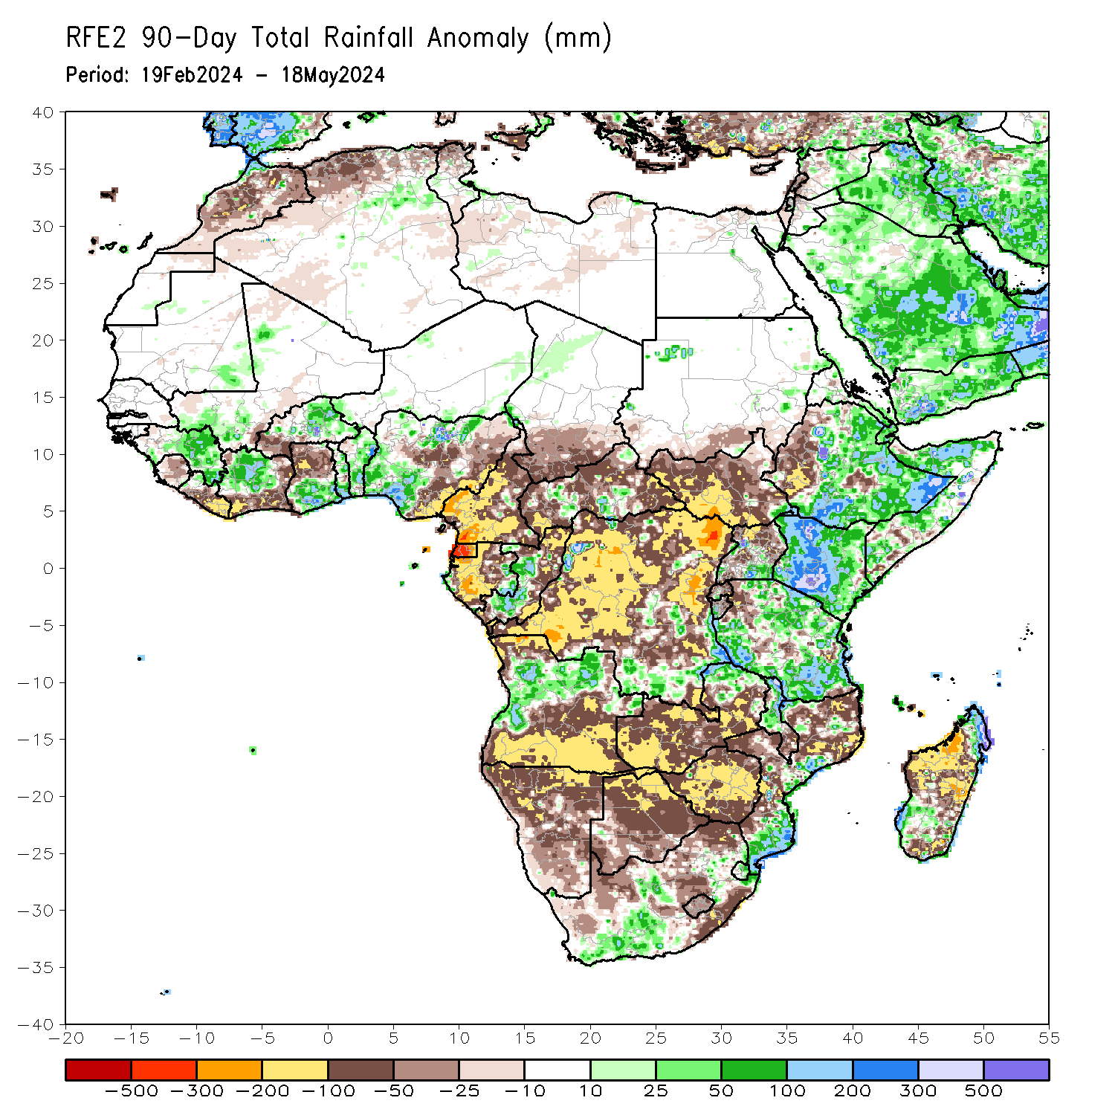
Rainfall Patterns: Last 90 Days
Over the past 90 days, in East Africa, rainfall was above-average in many parts of northeastern, central, southern and eastern Ethiopia, southern Eritrea, Djibouti, northern and western Somalia, many parts of Kenya, southeastern Uganda, western Burundi, and northern, southwestern and southeastern Tanzania. Rainfall was below-average in western and some localized regions in central Ethiopia, central Eritrea, southern Sudan, many parts of South Sudan, northern, western and central-eastern Uganda, many parts of Rwanda, eastern Burundi, and northwestern and some parts of central Tanzania. In Central Africa, rainfall was above-average in pocket of regions in eastern Gabon, western Congo, southern Central African Republic (CAR), and some regions in southern and southeastern Democratic Republic of the Congo (DRC). Rainfall was below-average in Cameroon, Equatorial Guinea, much of Gabon, northern and eastern Congo, southern Chad, northern, western, central and eastern CAR, and many parts of DRC. In West Africa, Rainfall was above-average in central and eastern Guinea, southeastern Mauritania, southwestern Mali, central and northern central Cote d’Ivoire, southern Ghana, central and eastern Burkina Faso, many parts of Togo and Benin, and northern, southwestern and southern Nigeria. Rainfall was below-average in Sierra Leone, many parts of Liberia, southern and eastern Cote d’Ivoire, western Burkina Faso, central and northern Ghana, and central, southeastern and eastern Nigeria. In southern Africa, rainfall was above-average in western and northeastern Angola, some parts in northern Zambia, northern and central Malawi, eastern and southern Mozambique, southeastern South Africa, much of Eswatini, and northern and southwestern Madagascar. Rainfall was below-average across southern, central and southeastern Angola, many parts of Namibia, Botswana, Zimbabwe and Lesotho, western, central, eastern and southern Zambia, southern Malawi, western, central and northern Mozambique, western, central and eastern South Africa, Lesotho, and western, central-eastern and southeastern Madagascar.
Notes:
4

Slide 5
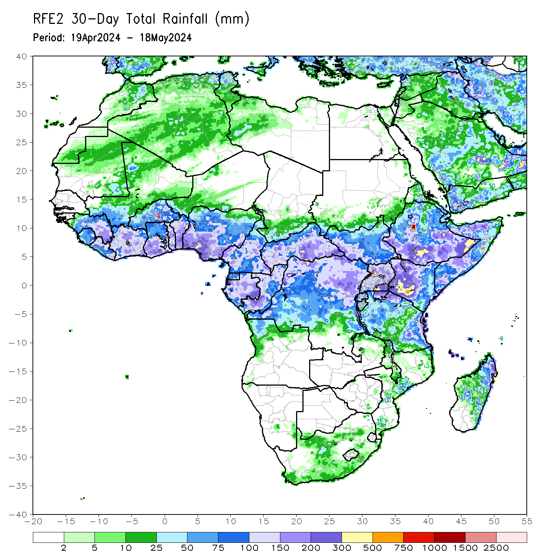
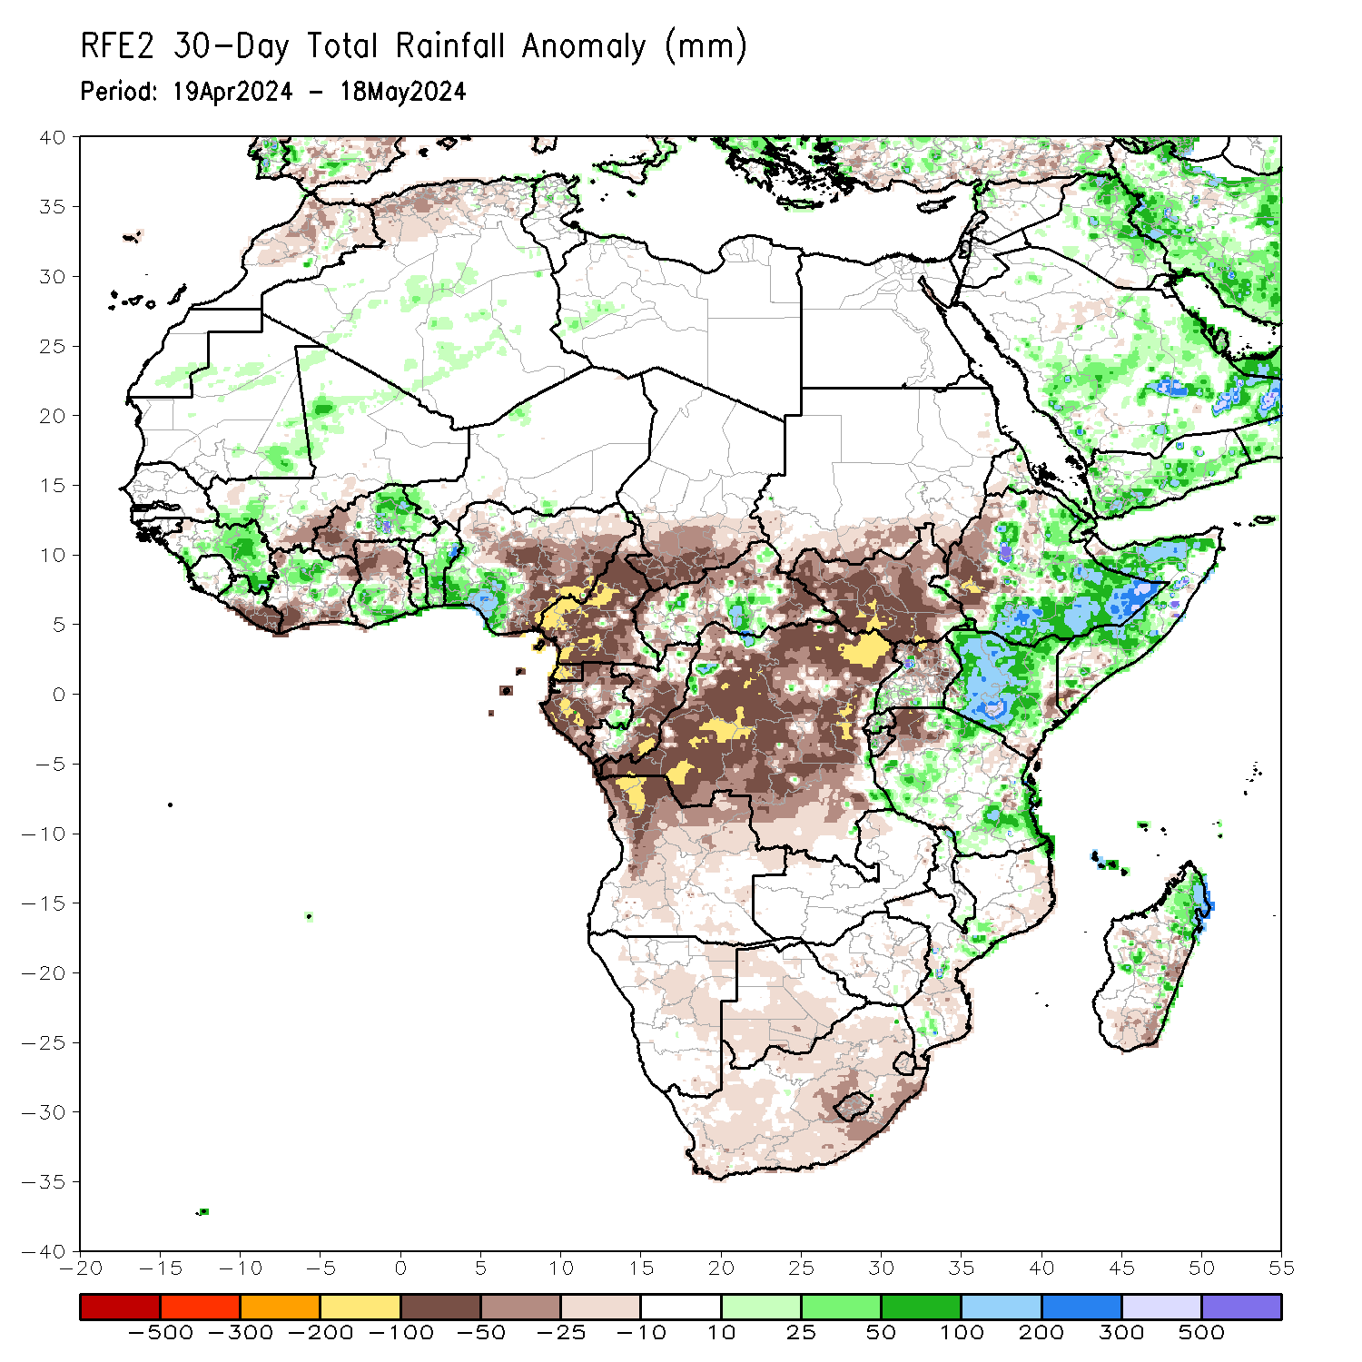
Rainfall Patterns: Last 30 Days
Over the past 30 days, in East Africa, rainfall was above-average in southern, eastern and northeastern Ethiopia, southern Eritrea, Djibouti, northern and central Somalia, most parts of Kenya, central and southern Rwanda, western Burundi, some parts of southern and northeastern Uganda, many parts of western, northern and eastern Tanzania. Rainfall was below-average in western Ethiopia, parts of northwestern Eritrea, southern Sudan, much of South Sudan, northern and central Uganda, parts of northwestern and northeastern Tanzania, eastern Burundi, and southeastern Rwanda. In Central Africa, rainfall was above-average in pockets of localized regions in eastern Gabon, southwestern and northern Congo and northwestern and southeastern Democratic Republic of the Congo (DRC), and areas in central and southern Central African Republic (CAR). Rainfall was below-average in Cameroon, Equatorial Guinea, many parts of Gabon, central and southeastern Congo, southern Chad, northern, eastern and western CAR, and much of DRC. In West Africa, Rainfall was above-average in central and eastern Guinea, southwestern and northwestern Mali, southeastern Mauritania, northwestern Liberia, central-northern Cote d’Ivoire, and southern Ghana, many parts of Togo and Benin, central and northern Burkina Faso, and southwestern Nigeria. Rainfall was below-average in areas in southeastern Mali, central and eastern Liberia, southern and northeastern Cote d’Ivoire, northern and eastern Ghana, western Burkina Faso, and central, eastern and southeastern Nigeria. In southern Africa, rainfall was above-average in some parts of central Mozambique, and northern and some localized regions central Madagascar. Rainfall was below-average across western, central and northern Angola, central Namibia, central and southern Botswana, many parts of South Africa, Lesotho. Eswatini, northeastern and southern Mozambique, and southern and some scatter regions in western-central and eastern Mozambique.
Notes:
5

Slide 6
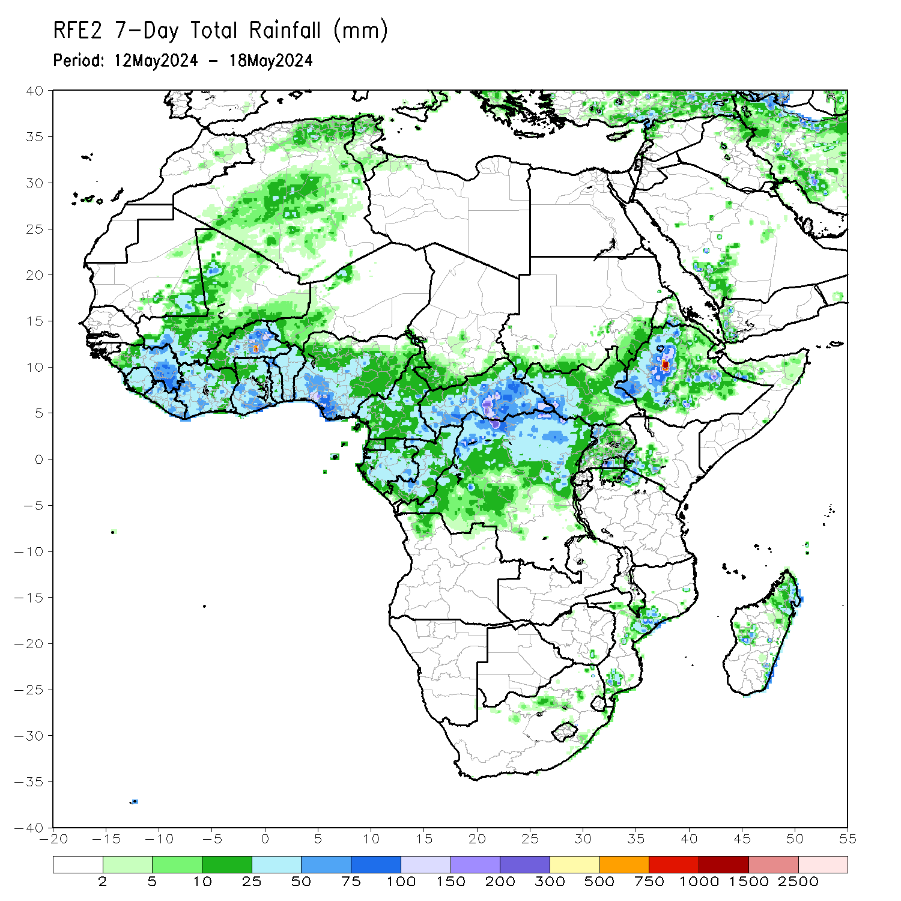
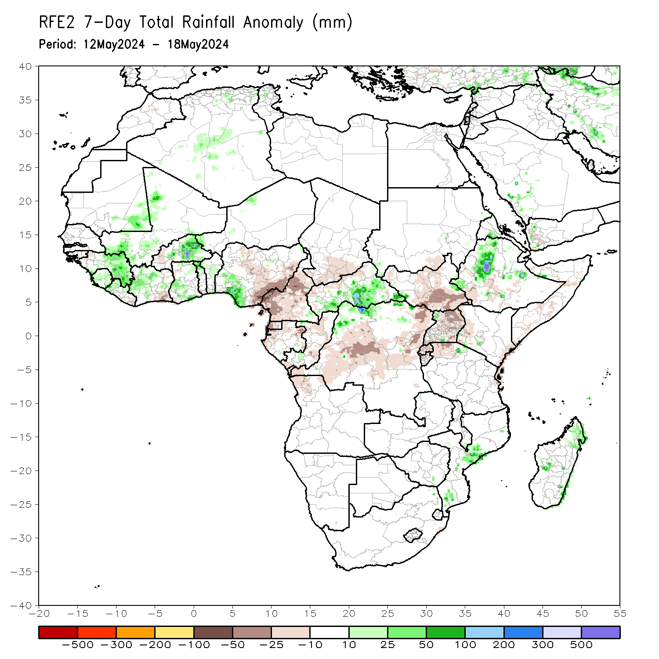
Rainfall Patterns: Last 7 Days
During the past 7 days, in East Africa, rainfall was above-average in northwestern and central parts of Ethiopia, and pocket of regions in western Eritrea, northwestern Uganda, northern Tanzania and some localized regions in eastern and western South Sudan. Rainfall was below-average in southwestern Ethiopia, some regions in central Somalia, northern, central, southern and southeastern South Sudan, many parts of Uganda and Rwanda, northern Burundi, northwestern Tanzania, and some parts of western and eastern Kenya. In central Africa, rainfall was above-average in parts of southeastern Cameroon, southwestern, central, southern and eastern parts of Central African Republic (CAR), and northwestern and northern parts of Democratic Republic of the Congo (DRC). Rainfall was below-average in central, eastern, western and southern Cameroon, Equatorial Guinea, some parts of western, northern and eastern Gabon, central Congo, southern Chad, northwestern and northern CAR, and southwestern, central, northeastern and eastern DRC. In West Africa, rainfall was above-average in southeastern Mauritania, some parts of western and southern Mali, central and eastern Guinea, Sierra Leone, western and northern Liberia, western and central-eastern Cote d’Ivoire, western, southern and northern Ghana, northern Togo, central Benin, and central and eastern Burkina Faso, and southern Nigeria. Rainfall was below-average in eastern Liberia, southeastern Cote d’Ivoire, western Burkina Faso, southern Togo, and central, southeastern and eastern Nigeria. In southern Africa, rainfall was above-average in some regions in central and southern Mozambique, and northern and some localized regions in western and southeastern Madagascar. Rainfall was below-average in the northern Angola region.

Slide 7
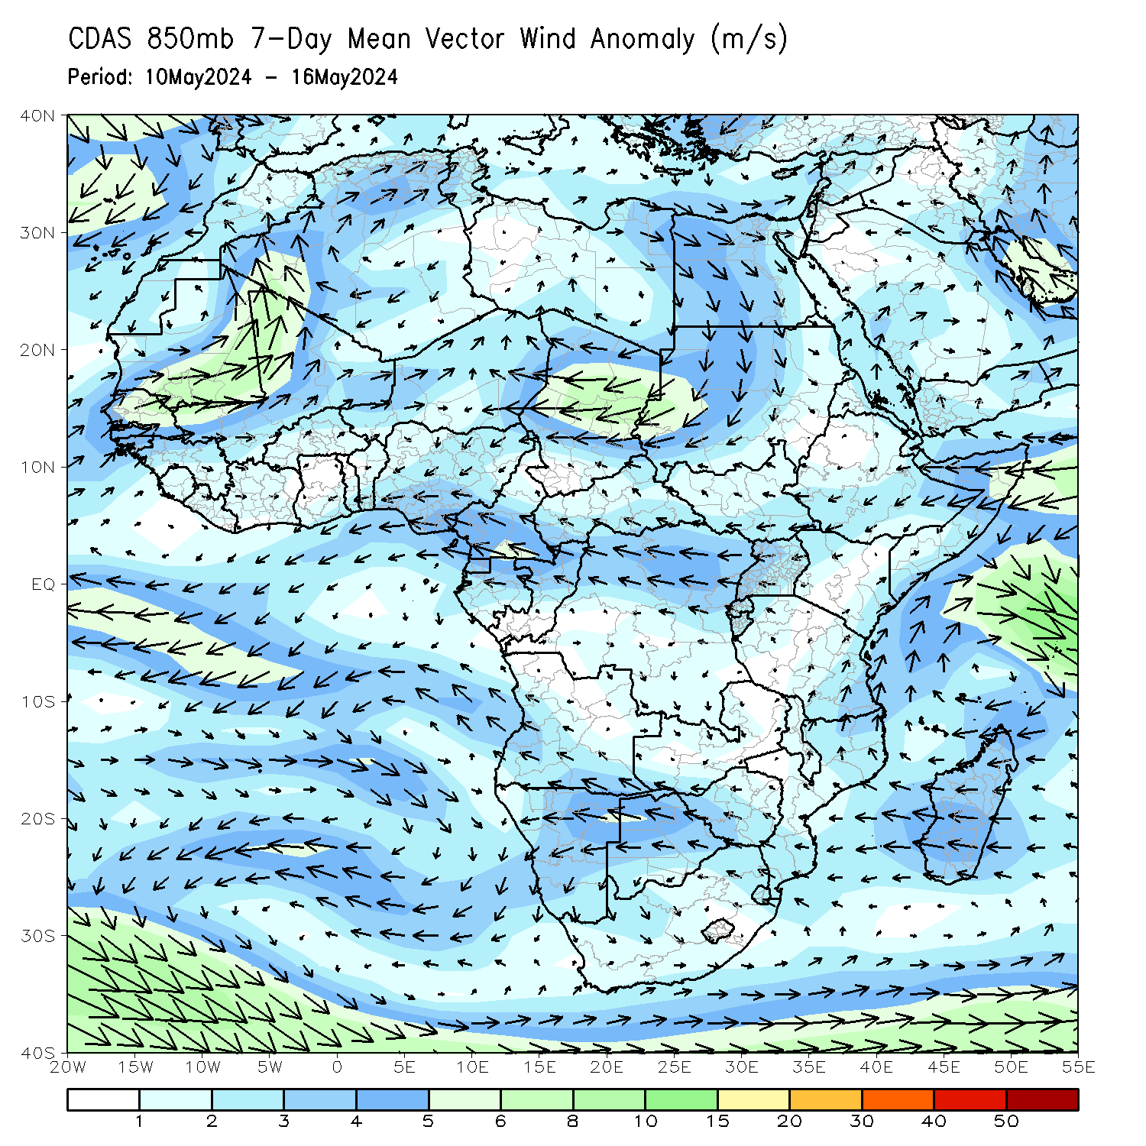
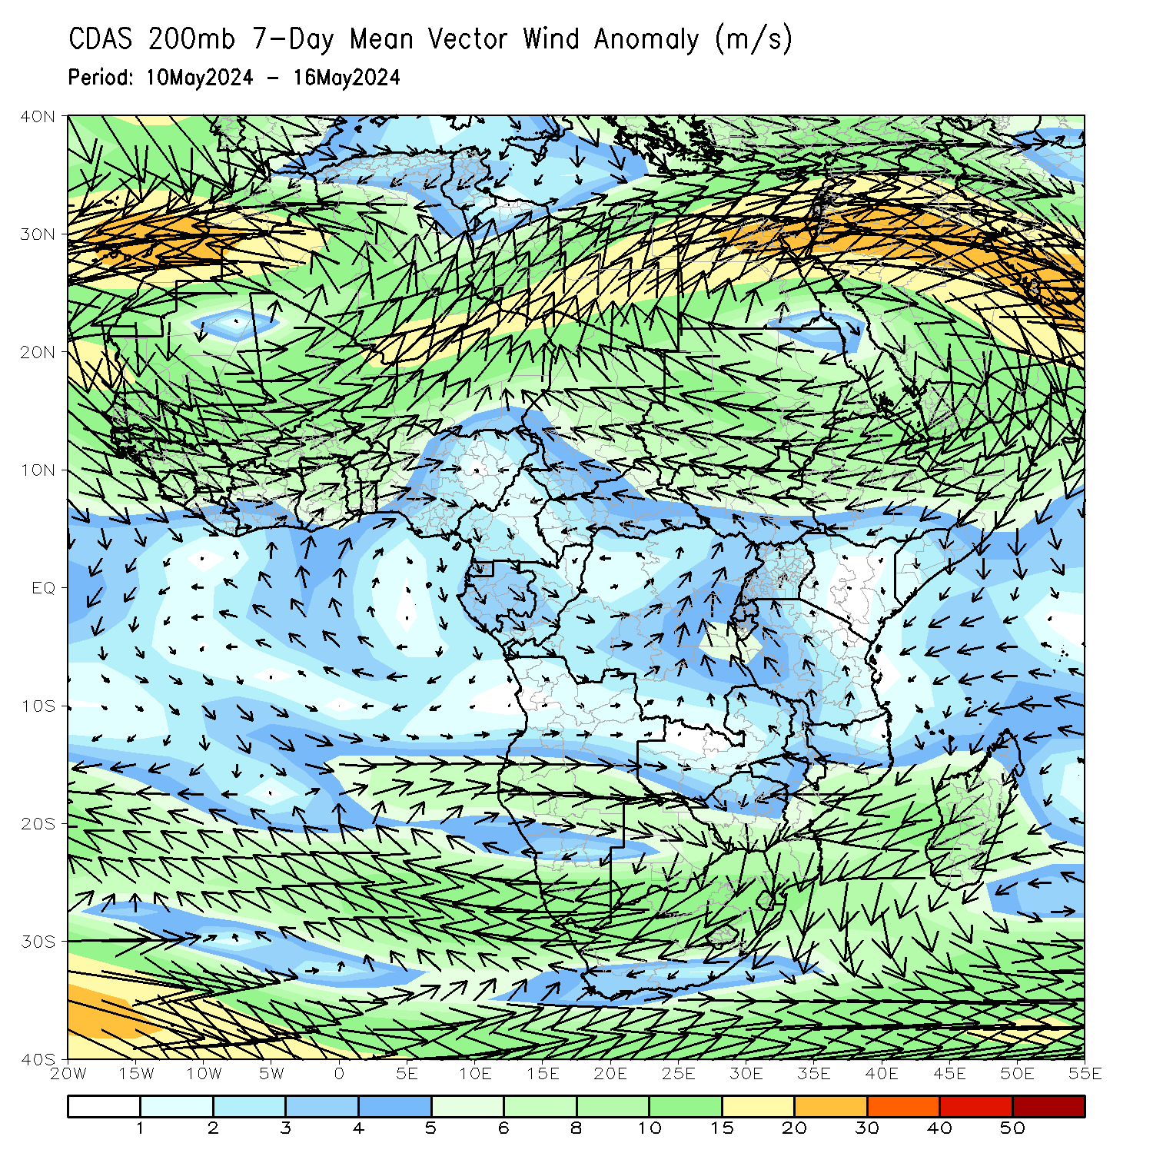
Atmospheric Circulation: Last 7 Days
At 700-hPa level (left panel), the anomalous lower-level convergence in northern Mali, and western Algeria may have contributed to the observed above-average rainfall in the region. The anomalous lower-level convergence in central Africa may have contributed to the observed above-average rainfall in many parts of Central African Republic (CAR) regions (left panel).

Slide 8
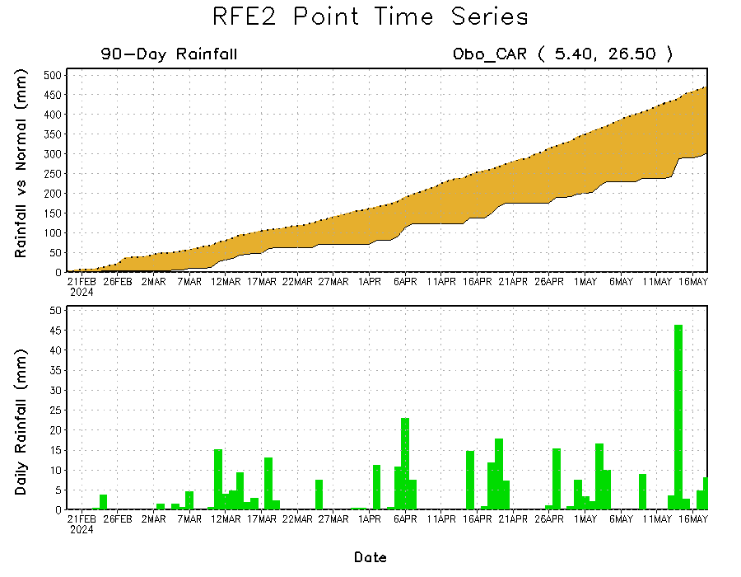
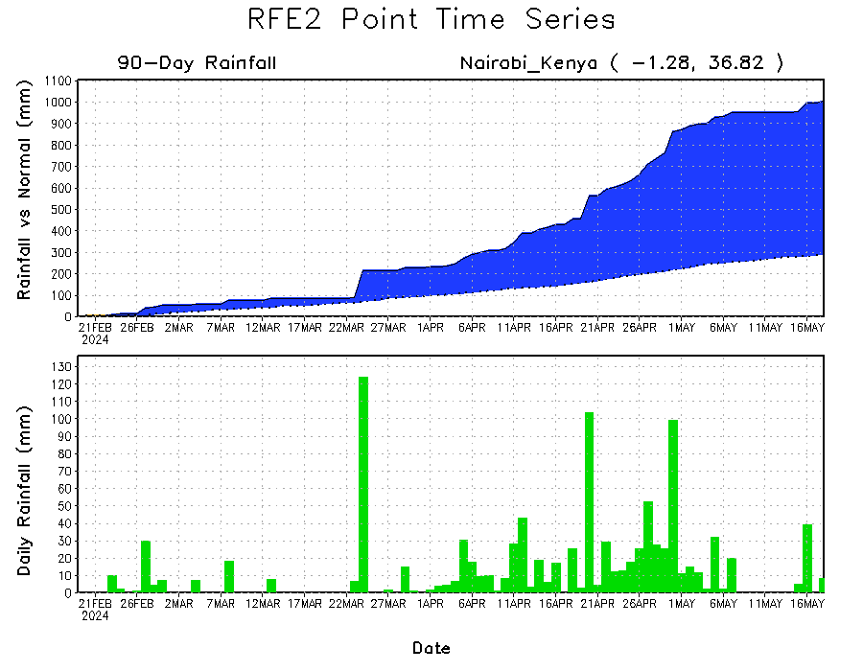
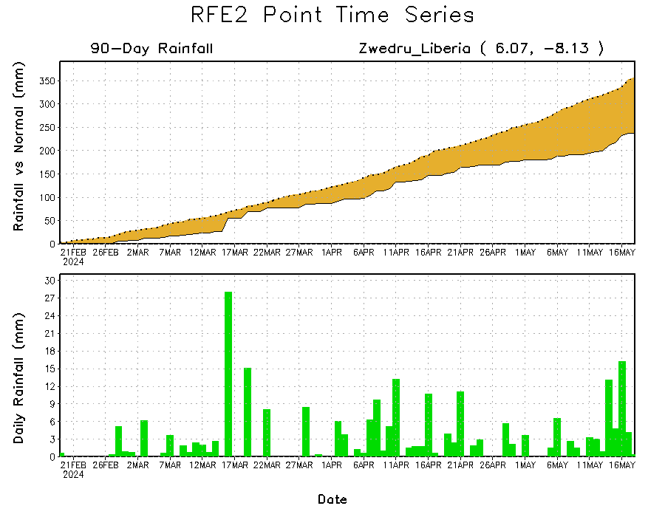
Rainfall Evolution
Daily evolution in rainfall at selected locations over the past 90 days shows growing deficits over eastern Liberia (bottom Left) and eastern Central African Republic (CAR) (top right). Conversely, rainfall surpluses persist in western and southern Kenya due to significant rainfall observed in the last 2-month period (bottom right).

Slide 9
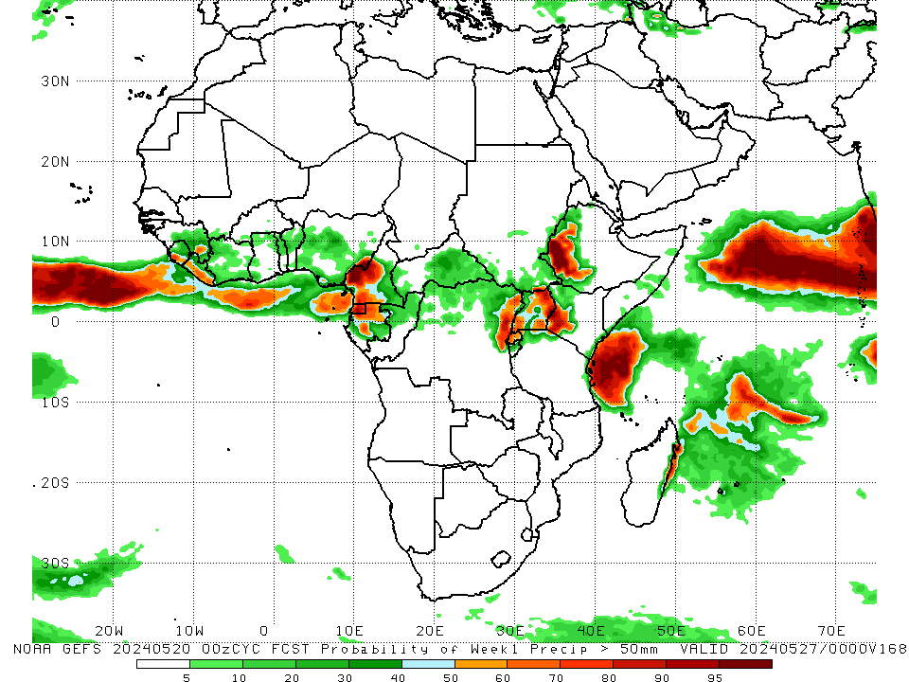
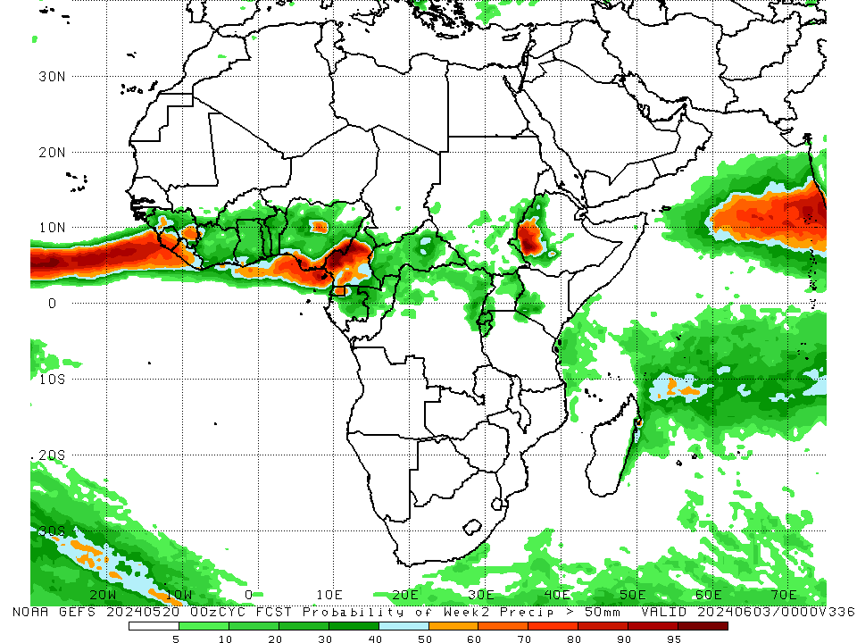
NCEP GEFS Model Forecasts Non-Bias Corrected Probability of precipitation exceedance
Week-1, Valid: 21 – 27 May 2024
Week-2, Valid: 28 May – 03 Jun 2024
For week-1 (left panel) the NCEP GEFS indicates a moderate to high chance (over 70%) for rainfall to exceed 50 mm over southern Sierra Leone, western and southwestern Cameroon, Equatorial Guinea, northern Gabon, some regions in eastern Democratic Republic of the Congo (DRC), western Rwanda, northeastern and eastern Uganda, southwestern Kenya, western Ethiopia, and some localized regions in eastern Kenya, northeastern Tanzania and eastern Madagascar. For week-2 (right panel), NCEP GEFS indicates a moderate to high chance (over 70%) for rainfall to exceed 50 mm in many parts of Sierra Leone, southwestern Liberia, southeastern Nigeria, central and western Cameroon, Equatorial Guinea, and western Ethiopia.
Notes:
9

Slide 10
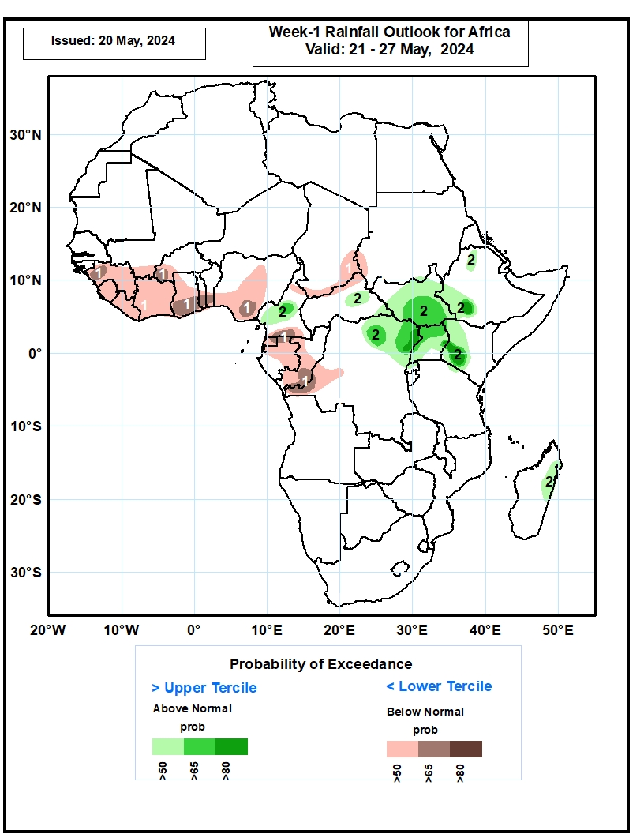
Week-1 Precipitation Outlooks
21 – 27 May 2024
The probabilistic forecasts call for above 50% chance for weekly total rainfall to be below-normal (below the upper tercile) over Guinea, Sierra Leone, Liberia, southern Mali, western Burkina Faso, Cote d’Ivoire, much of Ghana, southern Togo, southern Benin, central and southern Nigeria, northern and southern Cameroon, southern Chad, northern CAR, Equatorial Guinea, much of Gabon, much of Congo, and western DR Congo. There is above 65% chance for below-normal rainfall over western Guinea, southwestern Burkina Faso, southern Ghana, southern Togo, southern Benin, southeastern Nigeria, southern Cameroon, eastern Equatorial Guinea, northern Gabon, southern Congo, and western DR Congo.
The probabilistic forecasts call for above 50% chance for weekly rainfall to be above-normal (above the lower tercile) over central Cameroon, eastern CAR, much of South Sudan, southwestern and northern Ethiopia, northeastern DR Congo, much of Uganda, western Kenya, and eastern Madagascar. There is above 80% chance for above-normal rainfall over northeastern DR Congo, southwestern Ethiopia, and southwestern Kenya.
Notes:
10

Slide 11
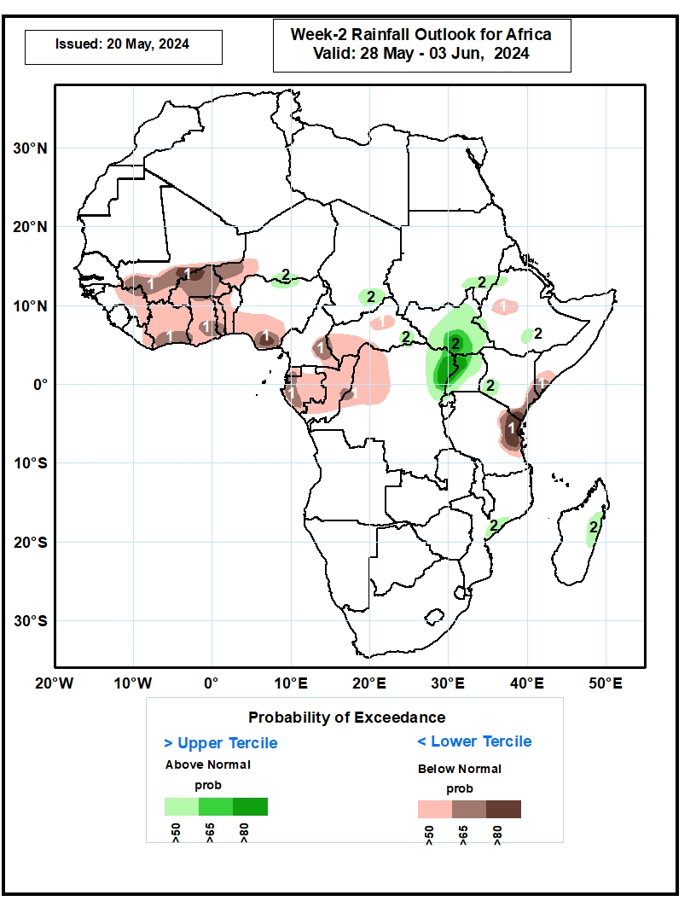
Week-2 Precipitation Outlooks
28 May – 03 Jun 2024
The probabilistic forecasts call for above 50% chance for weekly total rainfall to be below-normal (below the upper tercile) over central and eastern Guinea, southern Mali, eastern Liberia, Cote d’Ivoire, Ghana, Togo, Burkina Faso, western Niger, much of Benin, western and southern Nigeria, southeastern Cameroon, western and central CAR, Equatorial Guinea, Gabon, much of Congo, western DR Congo, central Ethiopia, southern Somalia, southern Kenya, and eastern Tanzania. There is above 80% chance for below-normal rainfall over east-central Mali, northwestern Burkina Faso, southeastern Nigeria, and eastern Tanzania.
The probabilistic forecasts call for above 50% chance for weekly rainfall to be above-normal (above the lower tercile) over south-central Niger, north-central Nigeria, southeastern Chad, southeastern CAR, southeastern Sudan, much of Sudan, northeastern DR Congo, western and northern Uganda, southwestern Kenya, western and southern Ethiopia, east-central Mozambique, and eastern Madagascar. There is above 80% chance for above-normal rainfall over southern South Sudan, northeastern DR Congo, and western Uganda.
Notes:
11

Slide 12
Summary
Over the past 30 days, in East Africa, rainfall was above-average in southern, eastern and northeastern Ethiopia, southern Eritrea, Djibouti, northern and central Somalia, most parts of Kenya, central and southern Rwanda, western Burundi, some parts of southern and northeastern Uganda, many parts of western, northern and eastern Tanzania. Rainfall was below-average in western Ethiopia, parts of northwestern Eritrea, southern Sudan, much of South Sudan, northern and central Uganda, parts of northwestern and northeastern Tanzania, eastern Burundi, and southeastern Rwanda. In Central Africa, rainfall was above-average in pockets of localized regions in eastern Gabon, southwestern and northern Congo and northwestern and southeastern Democratic Republic of the Congo (DRC), and areas in central and southern Central African Republic (CAR). Rainfall was below-average in Cameroon, Equatorial Guinea, many parts of Gabon, central and southeastern Congo, southern Chad, northern, eastern and western CAR, and much of DRC. In West Africa, Rainfall was above-average in central and eastern Guinea, southwestern and northwestern Mali, southeastern Mauritania, northwestern Liberia, central-northern Cote d’Ivoire, and southern Ghana, many parts of Togo and Benin, central and northern Burkina Faso, and southwestern Nigeria. Rainfall was below-average in areas in southeastern Mali, central and eastern Liberia, southern and northeastern Cote d’Ivoire, northern and eastern Ghana, western Burkina Faso, and central, eastern and southeastern Nigeria. In southern Africa, rainfall was above-average in some parts of central Mozambique, and northern and some localized regions central Madagascar. Rainfall was below-average across western, central and northern Angola, central Namibia, central and southern Botswana, many parts of South Africa, Lesotho. Eswatini, northeastern and southern Mozambique, and southern and some scatter regions in western-central and eastern Mozambique.
During the past 7 days, in East Africa, rainfall was above-average in northwestern and central parts of Ethiopia, and pocket of regions in western Eritrea, northwestern Uganda, northern Tanzania and some localized regions in eastern and western South Sudan. Rainfall was below-average in southwestern Ethiopia, some regions in central Somalia, northern, central, southern and southeastern South Sudan, many parts of Uganda and Rwanda, northern Burundi, northwestern Tanzania, and some parts of western and eastern Kenya. In central Africa, rainfall was above-average in parts of southeastern Cameroon, southwestern, central, southern and eastern parts of Central African Republic (CAR), and northwestern and northern parts of Democratic Republic of the Congo (DRC). Rainfall was below-average in central, eastern, western and southern Cameroon, Equatorial Guinea, some parts of western, northern and eastern Gabon, central Congo, southern Chad, northwestern and northern CAR, and southwestern, central, northeastern and eastern DRC. In West Africa, rainfall was above-average in southeastern Mauritania, some parts of western and southern Mali, central and eastern Guinea, Sierra Leone, western and northern Liberia, western and central-eastern Cote d’Ivoire, western, southern and northern Ghana, northern Togo, central Benin, and central and eastern Burkina Faso, and southern Nigeria. Rainfall was below-average in eastern Liberia, southeastern Cote d’Ivoire, western Burkina Faso, southern Togo, and central, southeastern and eastern Nigeria. In southern Africa, rainfall was above-average in some regions in central and southern Mozambique, and northern and some localized regions in western and southeastern Madagascar. Rainfall was below-average in the northern Angola region.
The Week-1 outlook calls for above-average rainfall in western Ethiopia, central Somalia, southeastern South Sudan, eastern Democratic Republic of the Congo (DRC), many parts of Uganda, western and eastern Kenya, and eastern Tanzania. In contrast, there is an increased chance for below-average in many parts of the Gulf of Guinea coast countries, equatorial and central Africa, southern Chad, southwestern Sudan, central and southeastern Ethiopia, and northwestern and southern Somalia. The Week-2 outlook calls for above-average rainfall in Sierra Leone, southern Niger, some parts of northern, central and southeastern Nigeria, central Cameroon, southwestern Ethiopia, and pocket of regions in southeastern Central African Republic (CAR) and central Mozambique. In contrast, there is an increased chance for below-average in Equatorial Guinea, Gabon, Congo, western, northern and central Congo, eastern Tanzania, southern Somalia, eastern Ethiopia, eastern Liberia, southern Cote d’Ivoire, Togo, central and southern Benin, and southwestern Nigeria.

